Slide 1

EE5003: Project Presentation on 15.November.2018
Multi agent Assisted Indoor Environmental Quality (IEQ) for Smart Buildings
Guided by
Assoc. Prof. Dr. Sanjib Kumar Panda
Electrical and Computer Engineering Department
Presented by
Aravind Madan Mohan
e0154145@u.nus.edu
Notes:
1
Good Afternoon. This is Aravind Madan Mohan. I will now be presenting the project EE5003- titled Multi-agent assisted Indoor Environmental quality for Smart Buildings. I take this opportunity to thank my guide Dr. Sanjib Kumar Panda and post docs Dr. Krishnanand and Dr. Chinh for their guidance during the course of the project.

Slide 2
Contents
Background and Motivation
IEQ: A brief overview
Modelling of the system
Indices of the room
Sensor Array and Data collection
Discussion of Results
Conclusion
2
Notes:
The topics that I will present in this presentation includes Background and Motivation, IEQ- A brief overview, Modelling of the system, Indices of the room, Sensor Array and data collection, Discussion of some of the results and then conclude the presentation

Slide 3
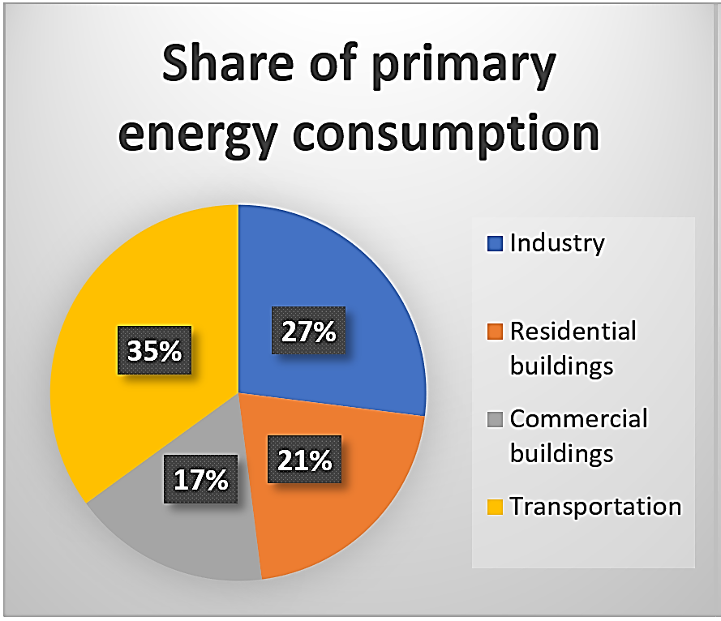
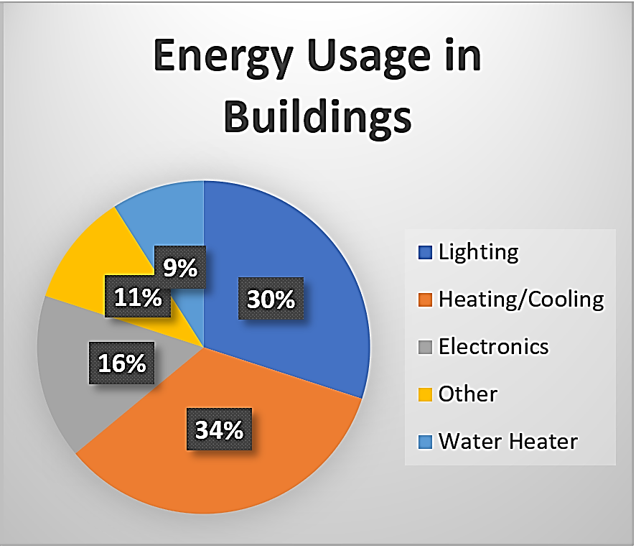
Background and Motivation
In urbanized areas most humans spend majority of their time indoors.
Buildings consume 39% of energy and HVAC systems and Lighting account for 64% of it.
https://www.seas.ucla.edu/~pilon/PCMIntro.html ; Ioan Susnea, Emilia Pecheanu, Adina Cocu, and Goran Hudec. Improved occupancybased solutions for energy saving in buildings. In Electrical and Electronics Engineering (IEEE), 2017 5th International Symposium on, pages 1–5. IEEE, 2017.
3
Notes:
The background motivation behind this project is about the energy that is being used by the Buildings. It amounts for about 39% of the energy consumed overall and in that portion the HVAC and Lighting consume 64% of the energy.

Slide 4
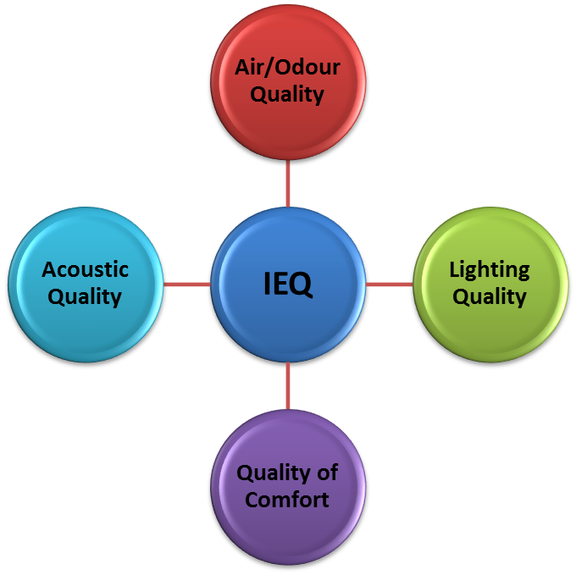
Background and Motivation
Closed environments – more prone to pollution and reduced quality of environment.
Three problems – Reduced quality of Environment, High Energy cost and less comfort
One Solution – Multi-agent assisted Indoor Environmental Quality
4
Notes:
The second background motivation is the buildings in urban areas have become more and more completely sealed environments which has reduced the quality of indoor air.
Three main problems present includes: Reduced quality of environment, high energy cost and less comfort of occupants. The Multi agent assisted IEQ is one of the solution.

Slide 5
Indoor Environmental Quality (IEQ) : A Brief Overview
World Health Organization Estimates (March 25th, 2014)
“… air pollution is now the world’s largest single environmental health risk. Reducing air pollution could save millions of lives.”
“… a total of 3.3 million deaths linked to indoor air pollution and 2.6 million deaths related to outdoor air pollution” (in South-East Asia and Western Pacific Regions)
Quartz India (November 6th, 2018)
“On Nov. 05, Delhi residents woke up to a haze of smog after the city’s pollution level reportedly hit 20 times the World Health Organization’s recommended limit.”
“Even before Diwali fireworks, Delhi’s air is already deadly”
http://www.who.int/mediacentre/news/releases/2014/air-pollution/en/ (based on WHO mortality data from 2012)
http://aqicn.org/city/italy/capo-granitola/cnr-isac/
https://qz.com/india/1451841/even-before-diwali-fireworks-delhis-air-is-already-deadly/
5
Notes:
Some of the quotes in famed organizations and news channels about Air pollution.

Slide 6
Indoor Environmental Quality (IEQ) : A Brief Overview
Four components of IEQ:
Thermal Quality – Temperature, Relative Humidity and Air Velocity.
Indoor Air Quality – concentration of gases - CO₂, CO, O₃, HCHO and VOC’s.
Lighting Quality – Better illuminance, colour temperature and less glare.
Acoustics Comfort – Very less noise, no echo and ease of communication.
6
Notes:
Coming to Indoor Environmental Quality: It is divided into four important qualities, Thermal Quality, Indoor Air quality, Lighting Quality and Acoustics Comfort.
Thermal quality is dependent on Temperature, Relative Humidity and Air Velocity.
IAQ is dependent on concentration of gases - CO₂, CO, O₃, HCHO and VOC’s.
Lighting depends on Better illuminance, colour temperature and less glare.
Acoustics Comfort depends on Very less noise, no echo and ease of communication.

Slide 7
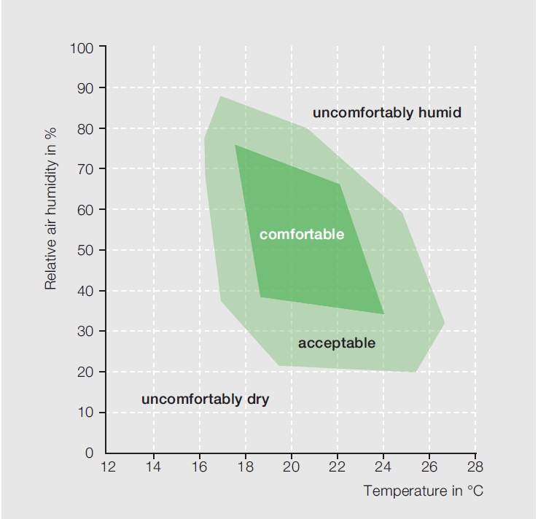
Indoor Environmental Quality (IEQ) : A Brief Overview
Thermal Quality:
Three parameters: Temperature, Relative Humidity and Air Velocity.
Standard range:
Temperature: 22.5 – 25 ºC
Relative Humidity: < 70 %
Air Velocity: < 0.25 m/sec
Comfort varies from each individual
Temperature vs Relative Humidity and Comfort Zone
Singapore B.C.A. BCA BUILDING ENERGY BENCHMARKING REPORT 2017,
7
Notes:
The standard ranges prescribed by Singapore B.C.A. BCA BUILDING ENERGY BENCHMARKING REPORT 2017 are the following:
The graph on the right shows the ranges of temperature and humidity where the region of comforts are demarked.

Slide 8
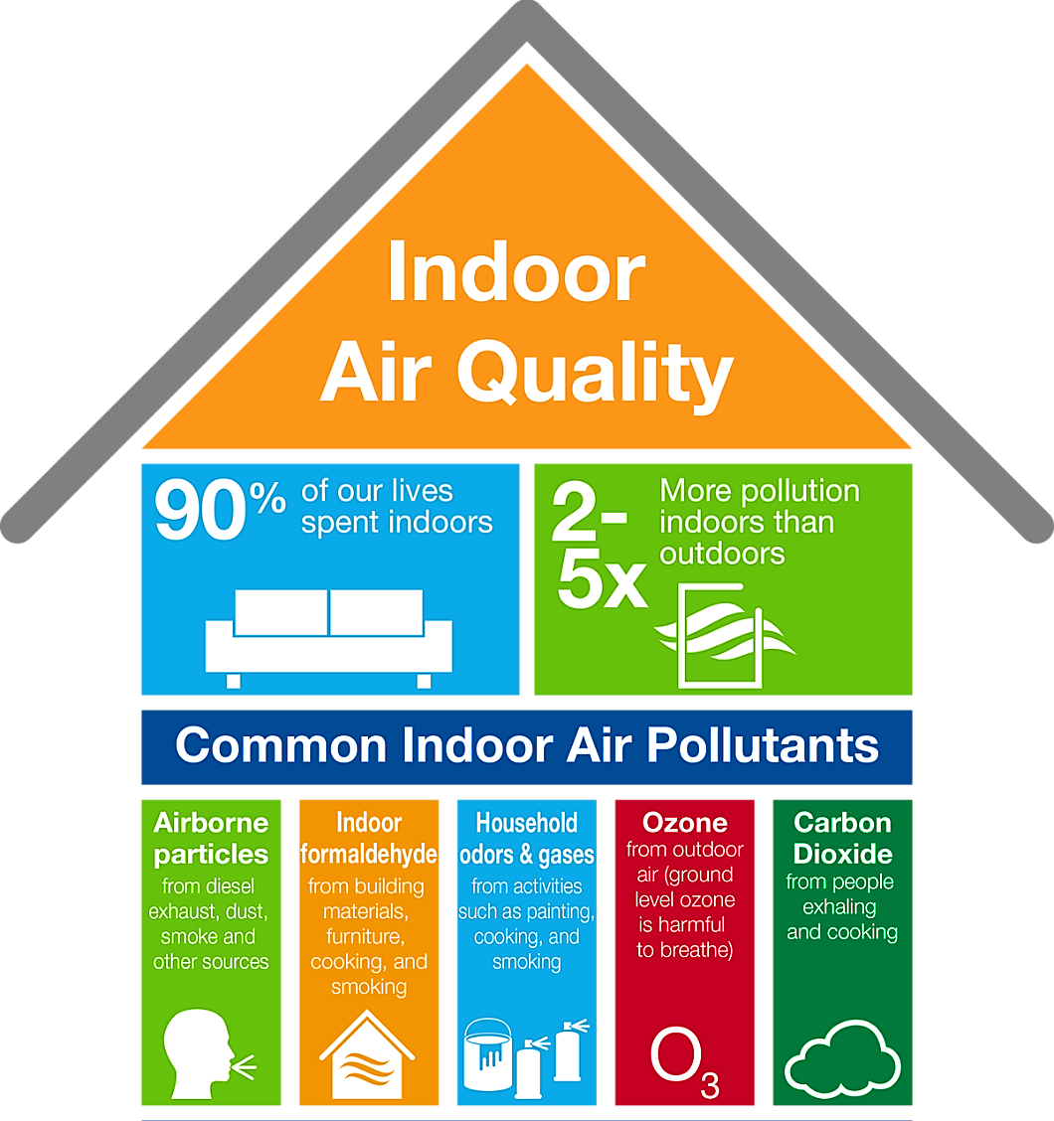
Indoor Environmental Quality (IEQ) : A Brief Overview
Indoor Air Quality:
Increase in closed spaces, reduction in fresh ventilation – result is reduction of air quality.
Gases of main interest – CO₂, CO, O₃, Formaldehyde (HCHO) and Volatile Organic Compounds (VOC’s) and Dust particles (PM 2.5 and PM 10).
Indoor Air Quality: Common Pollutants
https://catalysts.basf.com/products-and-industries/indoor-air-quality
8
Notes:
Air quality major problems as mentioned before increase of closed spaces, reduction in fresh ventilation and the result is reduction of indoor air quality.
The sources of common pollutants of air:
Air borne particles: dust, smoke and pollution due to vehicles
Formaldehyde: furniture, building material, cooking and smoking
Ozone: from outdoor air
Carbon dioxide: From people exhaling

Slide 9
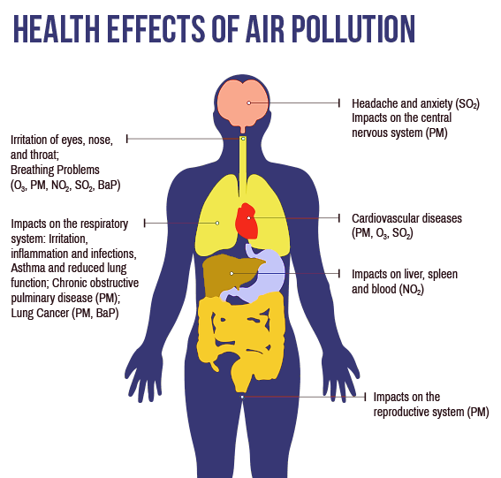
Indoor Environmental Quality (IEQ) : A Brief Overview
Air Quality:
Health Effects of Air Pollution (Outdoor and Indoor)
http://mccog.net/cleanairdare/air-quality-explained.html
9
Notes:
Some of health effects of air pollution both indoor and outdoor:

Slide 10
Indoor Environmental Quality (IEQ) : A Brief Overview
Indoor Air Quality:
European Countries | USA | London, UK
Dry Skin (32%) | Tired or Strained Eyes (33%) | Headache (44%)
Lethargy (31%) | Dry, itching, irritated eyes (30%) | Cough (36%)
Stuffy nose (31%) | Tiredness (27%) | Dry, itching, irritated eyes (33%)
Dry eyes (26%) | Headache (25%) | Blocked, running nose (27%)
Headache (19%) | Tension, irritability (23%) | Tired for no reason (25%)
Flu-like symptoms (14%) | Pain or stiffness of back (22%) | Rashes or itches (20%)
Chest Tightness (10%) | Stuffy or running nose (22%) | Cold, flu (19%)
Runny nose (11%) | Sneezing (18%) | Dry throat (18%)
Watering eyes (7%) | Sore or dry throat (16%) | Sore throat (17%)
Reduced Indoor Air Quality: Symptoms with % of occupants feeling it in different countries
Peder Wolkoff. Indoor air pollutants in office environments: assessment of comfort, health, and performance. International journal of hygiene and environmental health, 216(4):371–394, 2013.
10
Notes:
A survey of air quality and its symptoms: Reduced Indoor Air Quality: Symptoms with % of occupants feeling it in different countries

Slide 11
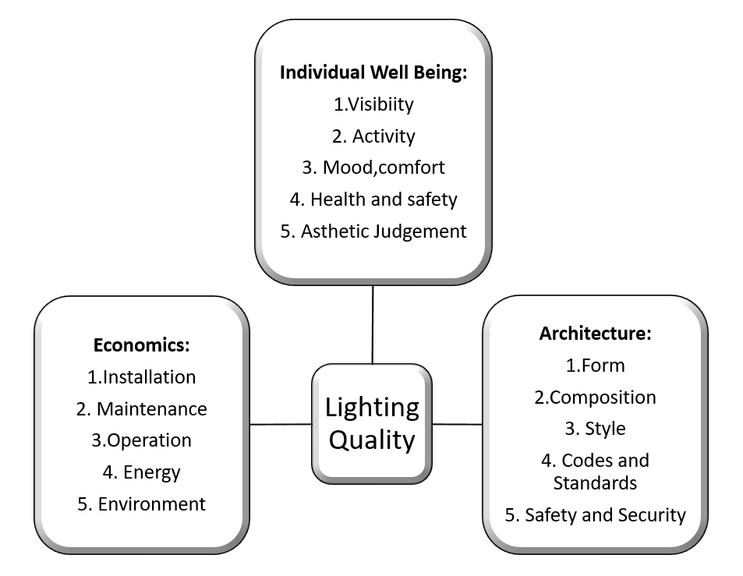
Indoor Environmental Quality (IEQ) : A Brief Overview
Lighting Quality:
Key parameters: Illuminance, Electrical and Day-light, Glare and Personal Comfort based control.
Least concerned - health and looked as a architectural aspect.
No immediate health effect but may lead to eye strain, headache, dizziness and lack of concentration.
Recommended level - Illuminating Engineering Society of North America (IESNA) is 500 lux at work place and 100 less surrounding it.
Components of Lighting Quality
11
Notes:
Next part of IEQ is lighting quality: The key parameters include Illuminance, electrical and day-light, glare and personal comfort.
Lighting quality is the least looked upon as in studying its health effects and more looked as a architectural aspect.
Health effects include eye strain, head ache, dizziness and lack of concentration in work.
The recommended level of lighting by Illuminating Engineering society of North America is 500 lux at workplace and 400 lux surrounding the work place.

Slide 12
Indoor Environmental Quality (IEQ) : A Brief Overview
Acoustic Quality:
Minimizing intruding noise and maintaining satisfaction among the occupants.
Reduction in noise – improved productivity and concentration.
Use of sound absorbents, carpets to reduce noise in indoor spaces.
Adjacency combinations |  | Sound level (dB)
Standard office | Standard office | 45
Executive office | Executive office | 50
Conference room | Conference room | 50
Office, conference room | Hallway, stairway | 50
Mechanical equipment room | Occupied area | 60
Sound level recommended by USGBC
12
Notes:
Acoustic quality is minimizing the noise and maintaining satisfaction among the occupants.
The reduction in noise improves the productivity and concentration of the occupants.
Sound absorbents are used in reducing the noise in indoor space.
The prescribed standard of sound level at office space by US Green Building Corporation.

Slide 13
Indoor Environmental Quality (IEQ) : A Brief Overview
Agent behaviour:
Characteristics:
Reacts to change in environment.
Goal oriented behavior.
Communicate with other agents to necessitate change.
Partially independent and autonomous.
Agents have a local view of the system except the central agent.
Decentralized control.
13
Notes:
Agent system in IEQ:
Agents are classified by the characteristics they possess
The following are some major characteristics of an individual agent:

Slide 14
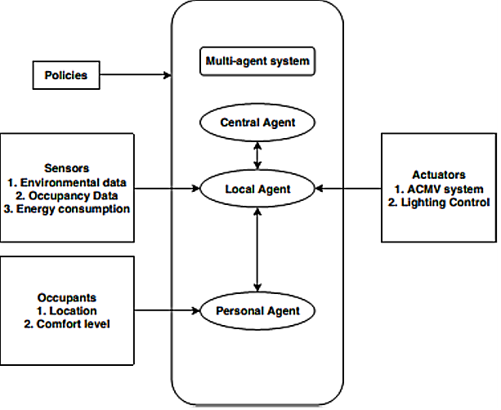
Indoor Environmental Quality (IEQ) : A Brief Overview
Multi-Agent System:
Building Management system (BMS)– controls ACMV systems, Lighting and Indoor Air constituents.
Multi-agent behavior can enhance the energy efficiency of BMS considering user feedback.
Decentralized control of environment.
Policies based on standards and comfort level.
Multi-agent System for IEQ
14
Notes:
Multi agent system in IEQ:
The following are the different agents in involved in a IEQ system
Local Agent – Sensor Array,
Central Agent, - the main software controlling all the systems
Occupant – Agent who can express discomfort and change set-point of the room to suit his comfort.
Policies – these are the standards that govern the central agent to take corrective action to maintain comfort and maintain the standards

Slide 15
APPENDIX
Multi-Agent System:
Agent | Functions
Sensor Array | Gives the presence of Occupant, temperature, humidity, concentration of gases to the central and local agent.
Human Beings | Supervise the local and central agents and provide set-points based on their comfort.
Lighting Controller | Keeps the lighting level as recommended by Human beings by communicating with Central Agent. Central agent instructs the Lighting controller based on the inputs from the Sensor array and Human being’s feedback.
ACMV system | Keeps the temperature and humidity level as recommended by Human beings by communicating with Central Agent. Central agent instructs the ACMV system based on the inputs from the Sensor array and Human being’s feedback.
Central Agent | It supervises all the control actions that needs to be coordinated with the local subsystems like lighting control and ACMV system by considering the feedback from Sensor array and the occupants. The occupants have a superior level of command over the central agent when deciding the comfort level.
Agents in Multi-agent System and their functions
15

Slide 16
Modelling of the System
Modelling of Building:
Many subsystems involved - Difficult in modelling of system by understanding the physical relationship between variables.
Requires precise relationship between variables for modelling.
Computationally inefficient and time consuming.
Complexity increases with increase in sub-systems.
16
Notes:
Modelling of the IEQ system for the Room FEC2 at NUS
The building consists of many subsystems that are difficult in modelling by differential equation by the physics that governs the relation between them.
This method of differential equation based modelling is difficult as the system is highly complex and involves many susbsystems.

Slide 17
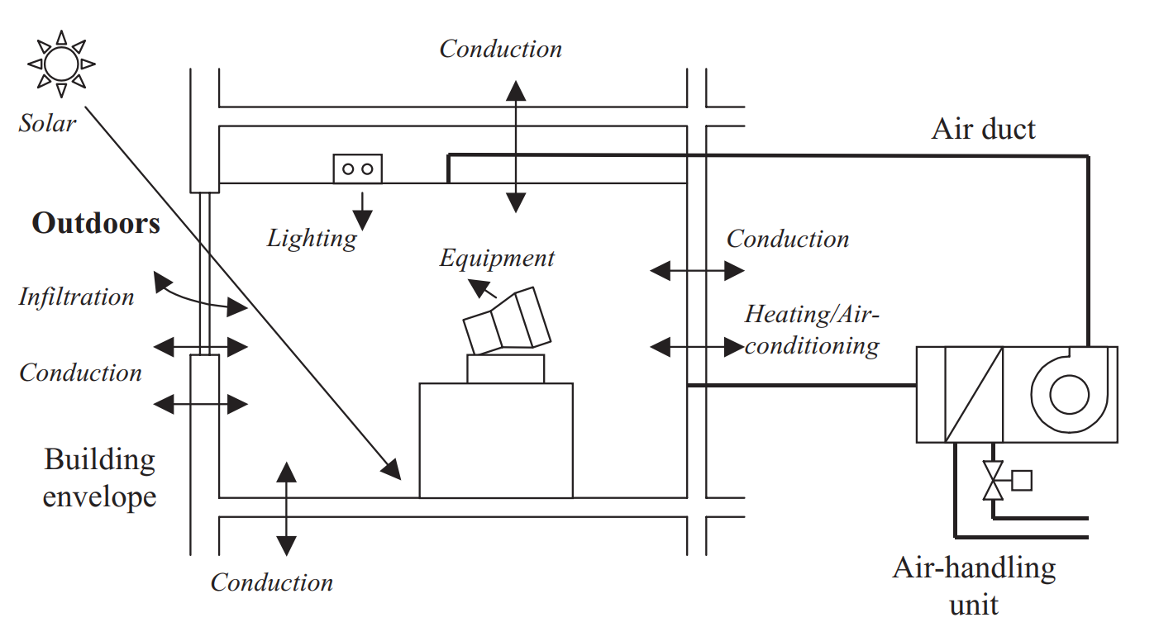
Modelling of the System
Thermal Model of the System:
Heat storage and transmission in the room two important thermal properties.
Influences the temperature and relative humidity in the room.
Temperature and Relative Humidity – controlled variable.
Controlled by quantity of heat Q removed by ACMV – manipulated variable.
Various Heat gains of a building
17
Notes:
The first subsystem model is the thermal model of the room:
Two thermal properties that causes variation in temperature are the heat storage and heat transmission
This influences the temperature and relative humidity of the room. These are the two variable that have to be controlled and hence they are the controlled variables
They are controlled by the ACMV system which removes the heat from the system and cools the room. The quantity of heat that is removed is the manipulated variable.
The figure on the right shows the various heat gains in the building due to lighting, equipment, human beings and external temperature.

Slide 18
Modelling of the System
Thermal Model of the System:
Heat and mass transfer processes | Building elements
Conduction and/or radiation heat transfer | External wall, roof, ceiling & floor slabs
Conduction heat transfer and solar radiation transmission. | Window glazing
Conduction and/or radiation heat transfer and moisture dissipation | Occupants, lights, and other equipment
Convection heat and mass transfer | Infiltration from outside and adjoin rooms/lobby
Building elements and their mode of heat transfer
18
Notes:
This table gives the heat transfer processes involved with building elements when subjected to heat.

Slide 19
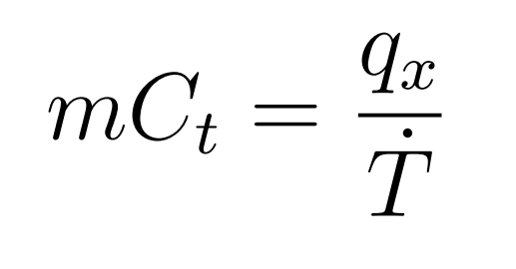
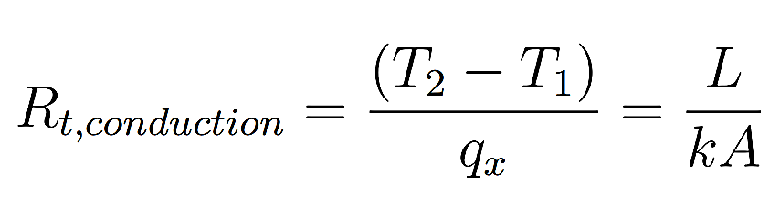
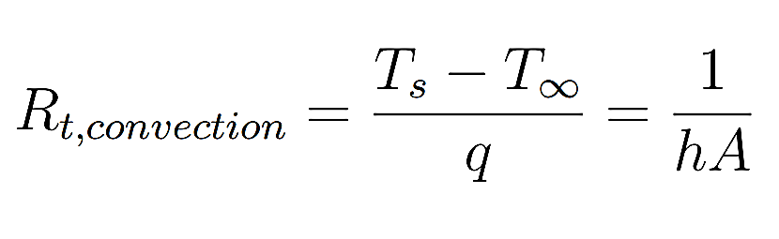
Modelling of the System
Thermal Capacitance and Resistance in Electrical Analogy:
Thermal Capacitance –
Thermal Resistance –
When heat transfer by conductance:
When heat transfer is by convection:
19
Notes:
Thermal Capacitance and Resistance in Electrical Analogy:
For Capacitance: C_{t} is the specific heat capacity, m is the mass of the object and Ṫ is the difference in temperature between surfaces.
For conductive heat transfer: T₁ and T₂ denote the temperature internal and external temperature. K is thermal conductivity, A is area of the wall and L is the width of the wall.
For convective heat transfer: T_{s} is the surface temperature and T∞ is the fluid temperature. h is the convective heat transfer coefficient.

Slide 20
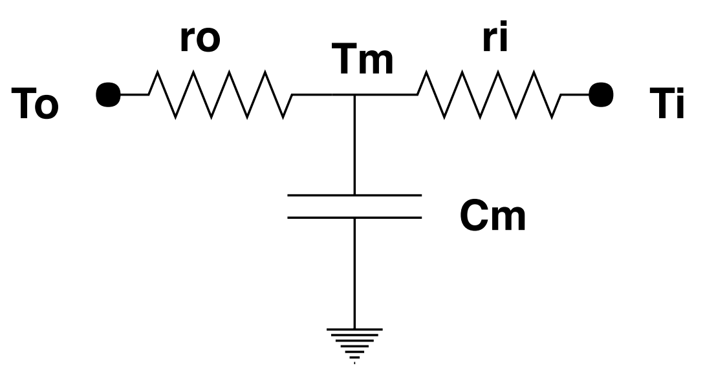
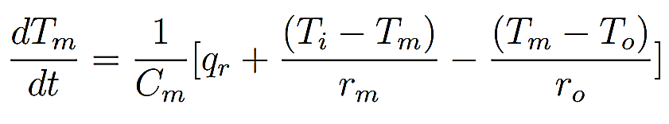
Modelling of the System
First order lumped capacitance model
Electrical model of the wall:
First order lumped capacitance:
Most commonly used to represent the individual unit of wall.
Ease of computation .
Can treat all elements of the buildings as lumped capacitance and provides uniform thermal response.
Differential equation governing the circuit:
Tm is the voltage across capacitance C_{m} .
r_{m} and C_{m} are the thermal resistance and capacitance of the material .
T_{i} and T_{o} are the internal and external temperatures.
20
Notes:
Electrical analogy of the thermal model based on first order lumped capacitance:
Used to represent the wall as a electrical circuit, where the thermal capacitance is in the form of capacitance and thermal resistance is the resistance in the circuit.
Main advantage is ease of computation. From the nodal equation for the node Tm the differential equation governing the circuit can be found to be:

Slide 21
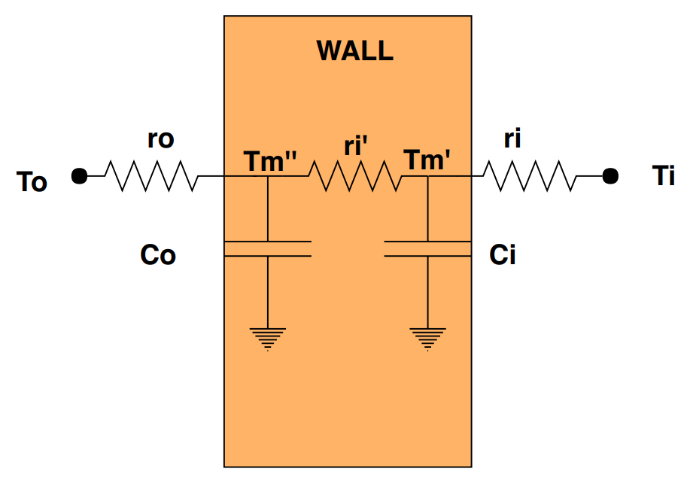
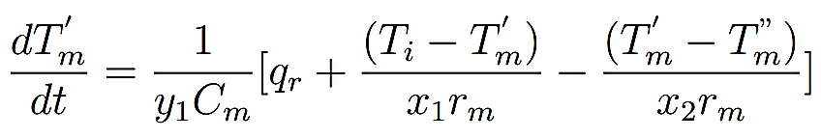
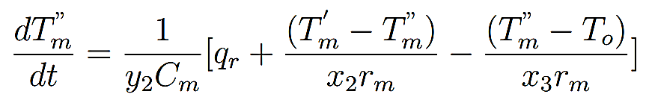
Modelling of the System
Electrical model of the wall:
Second order lumped capacitance:
First order model considers the material uniform and hence inaccurate.
Second order considers the material internal structure that adds to the heat transmission.
Differential equations governing the model:
Second order lumped capacitance model
21
Notes:
The first order model has some disadvantages like it considers the material to be uniform and single layered. Second overcomes by considering the internal structure of the element.
From the two nodes the differential equation governing the system are:
The x1 , x2 , x3 and y1, y2 are the coefficeints

Slide 22
Modelling of the System
Electrical model of the wall:
The coefficients sum to 1 for the thermal resistance and capacitance when they are considered equal for all the layers.
Second order lumped capacitance:
Second order lumped capacitance model
Coefficients | External Wall: Brick, concrete | Internal floor: Plaster board
x₁ | 0.111 | 0.1
x₂ | 0.506 | 0.482
x₃ | 0.383 | 0.418
y₁ | 0.186 | 0.211
y₂ | 0.814 | 0.789
Second order lumped capacitance model coefficients where x₁ + x₂ + x₃ =1 and y₁ + y₂ = 1
Chris Underwood and Francis Yik. Modelling methods for energy in buildings. John Wiley & Sons, 2008.
22

Slide 23
Modelling of the System
Assumptions considered for second order lumped model:
Air inside the room is well mixed.
Minimal variation of the temperature across the room.
All the elements of the building fit into the lumped capacitance model.
Heat flow is Isotropic.
Thermo-physical properties do not change with the temperature.
Pressure across the room is uniform so the heat flow is variant based on only temperature.
Radiation from the sun and temperature increase follows a pattern of sin-wave input since the data for variation is not available for consideration.
23

Slide 24
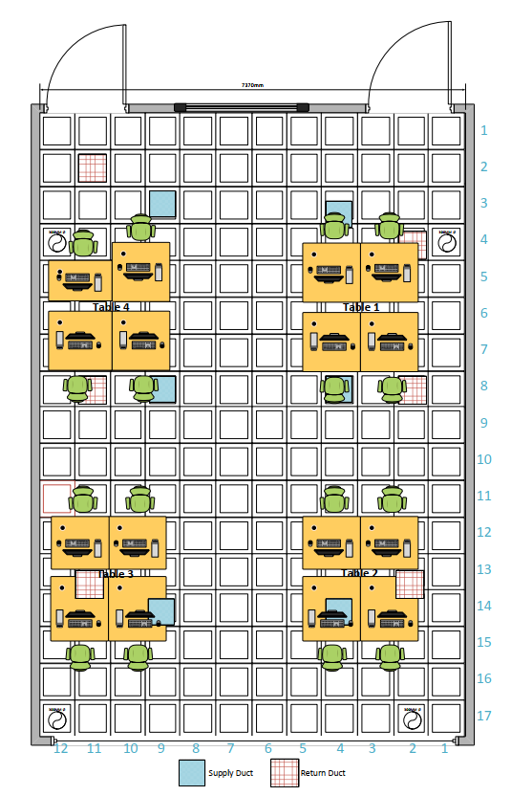
Modelling of the System
Floor Plan of the room
24

Slide 25
Modelling of the System
Thermal Modelling of the room:
Based on the second order lumped capacitance of wall.
Room under consideration FEC2 room, NUS.
Room dimensions Length = 10.11meter, Width = 7.37 meter, Height = 2.63meter.
Main assumptions:
Air is well mixed in the room
Floor and roof have similar properties to that of the other walls
Floor has no radiative effect on its temperature since it is not present in the ground floor.
All the constants are assumed from standard measurements.
Subsystems – 4 walls, roof, floor, heat gains from human, ACMV system, Lighting and other equipment.
25

Slide 26
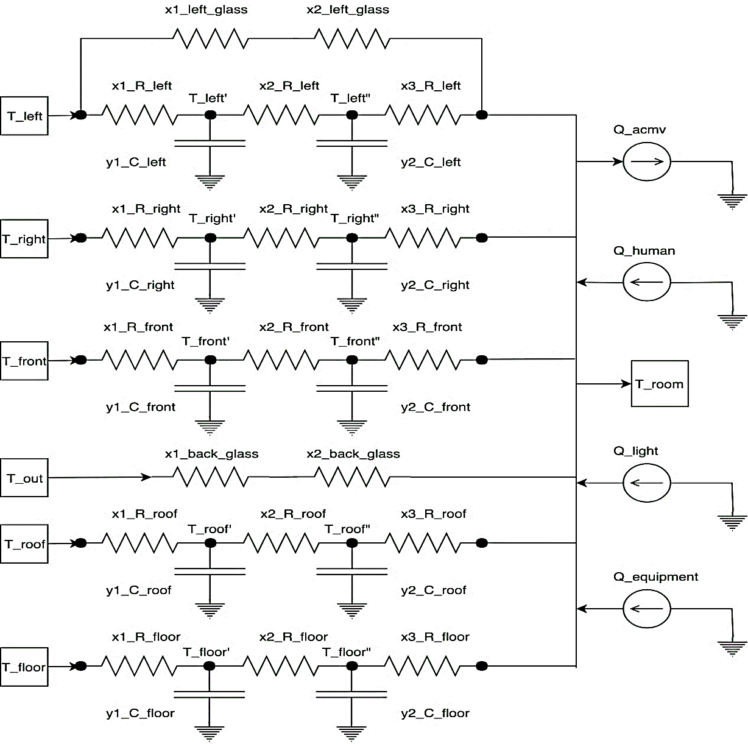
Modelling of the System
Lumped Capacitance Model
of the room
26

Slide 27
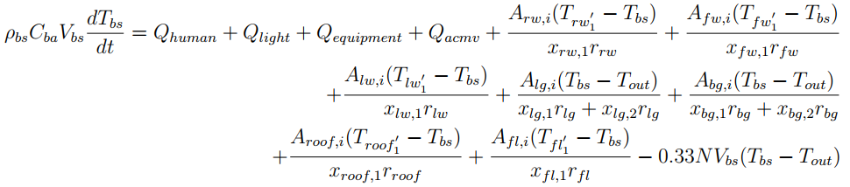
Modelling of the System
Thermal Modelling of the room
Differential equation governing the system:
By heat balance equation:
Internal energy = Heat gains + work done
27
Notes:
ρbs : Density of air in building space in kg=m3 Cba : Specific heat capacity of air in building space in J=kgK Vbs : Volume in building space in m3 Tbs : Temperature of air in building space in oC A : Area of the element under consideration in m2 Qhuman : Heat gain due to occupants in W Qlight : Heat gain due to lighting in W Qequipment : Heat gain due to equipment in the room in W Troof : Temperature at surface of roof in oC Tr : Temperature at surface of right wall in oC Tl : Temperature at surface of left wall in oC Tlg : Temperature at surface of left glass wall in oC Tf : Temperature at surface of front wall in oC Tbg : Temperature at surface of back glass wall in oC Tfl : Temperature at surface of floor in oC xlw; xrw; xfw; xroof; xfl are the resistance of individual models of left wall, right wall, front wall, roof, and flooring. xlg; xbg are the resistance of individual models of left glass wall and back glass wall. N : number of times the ACMV system needs to replace the air in the room space.

Slide 28
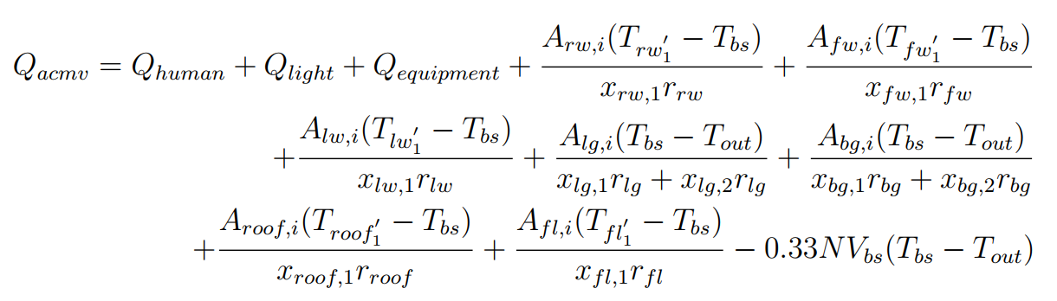
Modelling of the System
Thermal Modelling of the room:
Differential equation governing the system:
At the steady state: indoor temperature constant when ACMV working
=> Its derivative is constant.
28
Notes:
ρbs : Density of air in building space in kg=m3 Cba : Specific heat capacity of air in building space in J=kgK Vbs : Volume in building space in m3 Tbs : Temperature of air in building space in oC A : Area of the element under consideration in m2 Qhuman : Heat gain due to occupants in W Qlight : Heat gain due to lighting in W Qequipment : Heat gain due to equipment in the room in W Troof : Temperature at surface of roof in oC Tr : Temperature at surface of right wall in oC Tl : Temperature at surface of left wall in oC Tlg : Temperature at surface of left glass wall in oC Tf : Temperature at surface of front wall in oC Tbg : Temperature at surface of back glass wall in oC Tfl : Temperature at surface of floor in oC xlw; xrw; xfw; xroof; xfl are the resistance of individual models of left wall, right wall, front wall, roof, and flooring. xlg; xbg are the resistance of individual models of left glass wall and back glass wall. N : number of times the ACMV system needs to replace the air in the room space.

Slide 29
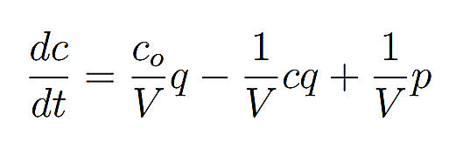
Modelling of the System
Air Quality of the room:
Differential equation governing the CO₂ concentration:
CO₂ concentration depends directly on the number of persons present in the room.
c₀ , c are the concentration of Carbon dioxide at the outdoor and indoor. V is the volume of the room, q is the outdoor fresh air intake by ACMV system, p is the amount of CO₂ that is let in by the people in the room.
29
Notes:
Second subsystem in modelling is the air quality:
Concentration of CO2 is increased due to two factors. One is the outdoor CO2 that is being brought in by the ACMV system and the second is the CO2 exhaled by the human beings in the room.
The change of CO2 concentration with time is dependent on the external CO2, volume of the room, outdoor air intake and CO2 generated by human beings,

Slide 30
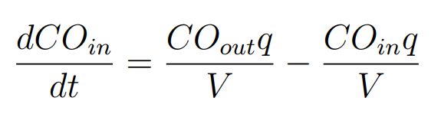
Modelling of the System
Air Quality of the room:
Differential equation governing the CO concentration:
CO concentration depends on the outside air and not on human beings as they do not generate CO
CO_{in} and CO_{out} are the concentration of Carbon monoxide at the inside and outside of the room. V is the volume of the room, q is the outdoor fresh air intake by ACMV system.
30
Notes:
Concentration of CO is increased the outdoor CO2 that is being brought in by the ACMV and does not depend on Human beings, The change of CO concentration with time is dependent on the external CO, volume of the room, outdoor air intake.

Slide 31
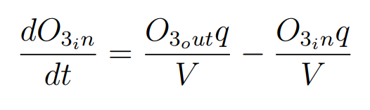
Modelling of the System
Air Quality of the room:
Differential equation governing the O₃ concentration:
O₃ concentration depends on the outside air and not on human beings as they do not generate O₃ .
O_{3in} and O_{3out} are the concentration of Ozone at the inside and outside of the room. V is the volume of the room, q is the outdoor fresh air intake by ACMV system.
31
Notes:
Ozone has a similar relation like that of CO

Slide 32
Indices of the Room
Thermal Comfort Index:
Predicted Mean Value: (ASHRAE 55:2017)
Predicts the comfort level of people theoretically.
Uses: air temperature, radiant temperature, relative humidity, air speed, metabolic rate and clothing insulation.
PMV value
-3 | -2 | -1 | 0 | 1 | 2 | 3
Cold | Cool | Slightly Cool | Neutral | Slightly Warm | Warm | Hot
32
Notes:
Thermal comfort index describes the comfort level of the occupants. ASHRAE 55 standard has prescribed two index that are calculated theoretically taking into account
air temperature, radiant temperature, relative humidity, air speed, metabolic rate and clothing insulation.

Slide 33
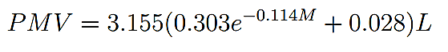
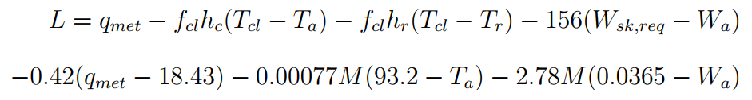
Indices of the Room
Thermal Comfort Index:
Predicted Mean Value:
where:
Predicted Percentage of Dissatisfaction:
Gives the predicted value of occupants to be dissatisfied by the given conditions.
33
Notes:
M : metabolic rate per unit area in BT U=hrft2 L : evaporative losses influenced by skin temperature in BT U=hrft2 Tcl : average surface temperature of the body in deg. F fcl : ratio of clothed surface area to DuBois surface area Rcl : effective thermal resistance (R-value) of clothing ft2oFhr=BT U Ta : Temperature of the room in oF hc :convection heat transfer coefficient in BT U=hrft2oF Tr : Mean radiant Temperature of the room in oF hr :radiative heat transfer coefficient in BT U=hrft2oF Wa : Humidity ratio Wsk : saturated Humidity ratio at skin temperature predicted
SurfaceareaDuBois = 0:20247(height)0:725(weight)0:425

Slide 34
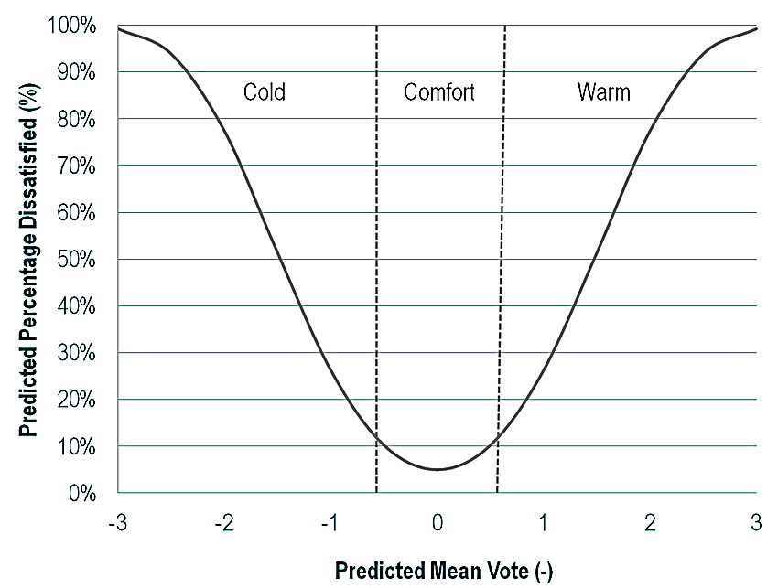
Indices of the Room
Thermal Comfort Index:
Relation between Predicted Mean Value and Predicted Percentage of Dissatisfaction:
34

Slide 35
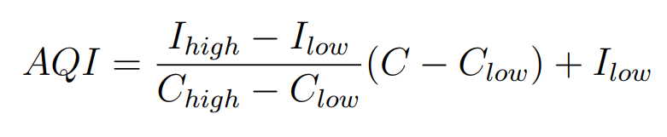
Indices of the Room
Air Quality Index:
Most common index of quality and pollution measurement. Gives a number that can give the severity of the pollution present. Singapore refers to it has Pollution Standards Index (PSI)
35
Notes:
AQI :The Air Quality Index
Ihigh :Index break-point corresponding to Chigh Ilow :Index break-point corresponding to Clow C :Pollutant Concentration Clow :Concentration break-point that is ≤ C Chigh :Concentration break-point that is ≥ C

Slide 36
Indices of the Room
Air Quality Index:
O3(ppb)(8 - hr) | O3(ppb)(1 - hr) | PM2:5(µg=m3) | PM10(µg=m3) | CO(ppm) | AQI | AQI
C_{low} - C_{high} (avg) | C_{low} - C_{high} (avg) | C_{low}- C_{high} (avg) | C_{low} - C_{high} (avg) | C_{low} - C_{high} (avg) | I_{low} - I_{high} | Category
0-54 | - | 0.0-12.0 | 0-54 | 0.0-4.4 | 0-50 | Good
55-70 | - | 12.1-35.4 | 55-154 | 4.5-9.4 | 51-100 | Moderate
71-85 | 125-164 | 35.5-55.4 | 155-254 | 9.5-12.4 | 101-150 | Unhealthy
86-105 | 165-204 | 55.5-150.4 | 255-354 | 12.5-15.4 | 151-200
106-200 | 205-404 | 150.5-250.4 | 355-424 | 15.5-30.4 | 201-300 | Very Unhealthy
- | 405-504 | 250.5-350.4 | 425-504 | 30.5-40.4 | 301-400 | Hazardous
- | 505-604 | 350.5-500.4 | 505-604 | 40.5-50.4 | 401-500
ANSI ASHRAE. Ashrae/ies standard 55-2013, thermal environmental conditions for human occupancy. American Society of Heating, Air-Conditioning and Refrigeration Engineers, Inc, Atlanta, 2013.
36

Slide 37
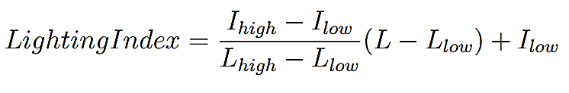
Indices of the Room
Lighting Index:
Index based on standards of International Association of Light Designers.
Recommended level of lighting is 500 lux at work place, 300-400 surrounding it.
It ranges between 0 – 100 where 0 refers to compiles with the standards and 100 refers to either it is too dark or too bright.
37
Notes:
LightingIndex :The Lighting quality Index L :Intensity of Light at the point Llow :Intensity of Light break-point that is ≤ L Lhigh :Intensity of Light break-point that is ≥ L Ihigh :Index break-point corresponding to Lhigh Ilow :Index break-point corresponding to Llow

Slide 38
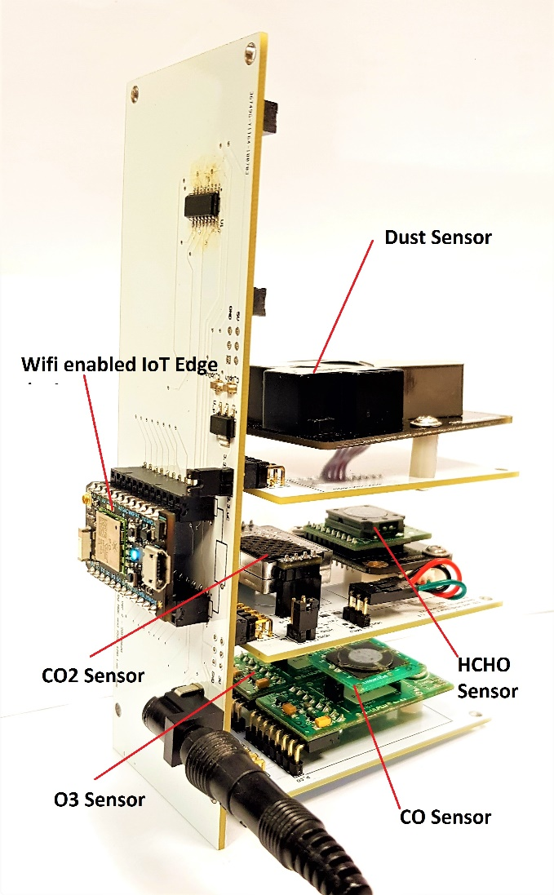
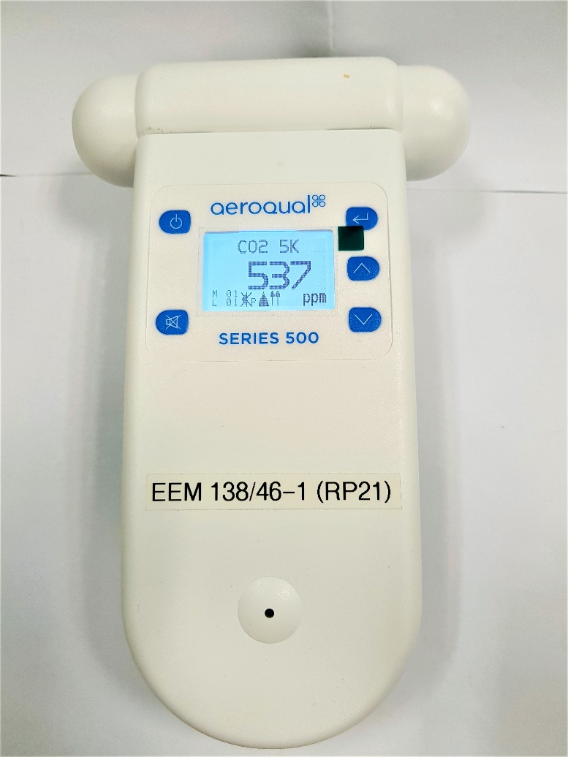
Sensor Array and Data Collection
Sensor Array and Commercial Sensor used
38

Slide 39
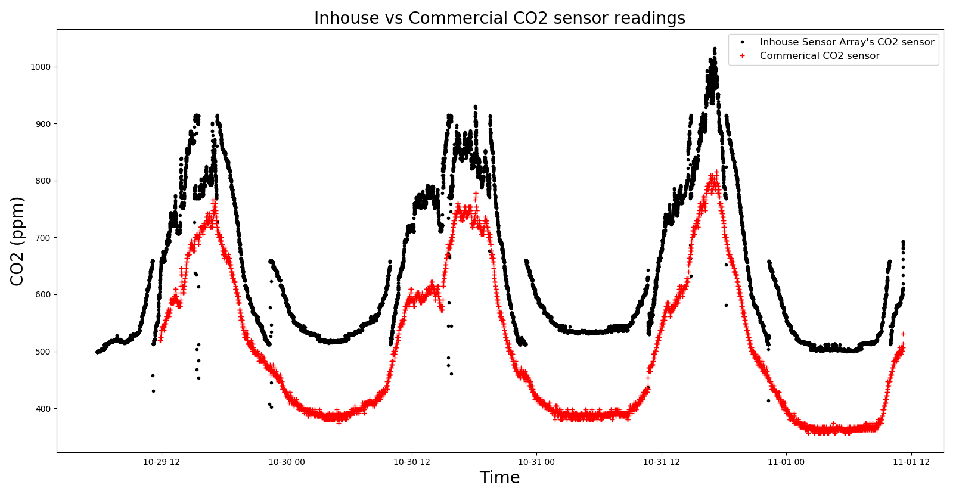
Sensor Array and Data Collection
Actual CO₂ concentration – Commercial vs Inhouse sensor array
39
Notes:
The variation of CO2 during the time 12:00 noon of 29th October to 12 noon of 1st November for inhouse sensor array and a commercial sensor.

Slide 40
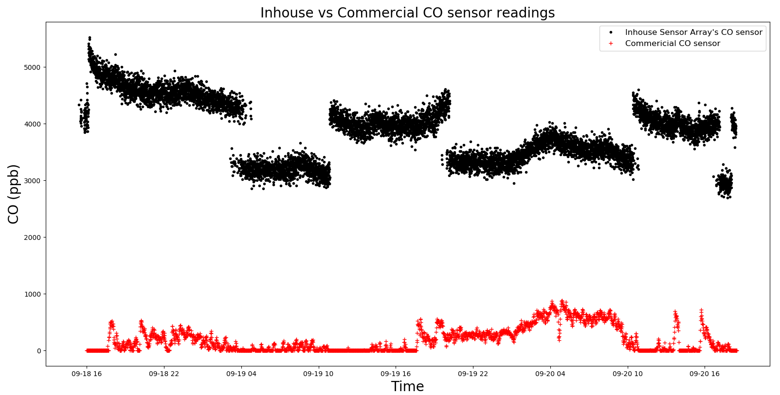
Sensor Array and Data Collection
Actual CO concentration – Commercial vs Inhouse sensor array
40
Notes:
The variation of CO during the time 4pm afternoon of 18th September to 4pm of 20th September for inhouse sensor array and a commercial sensor.

Slide 41
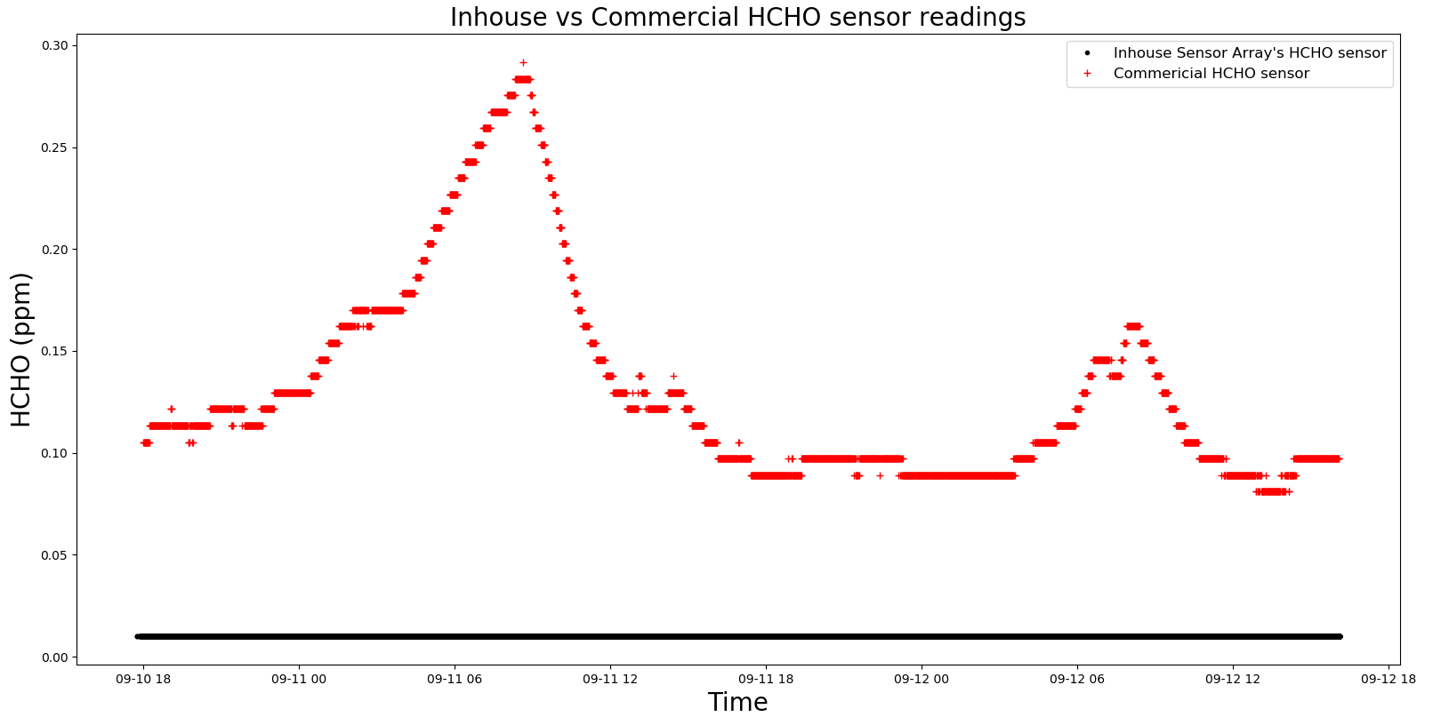
Sensor Array and Data Collection
Actual HCHO concentration – Commercial vs Inhouse sensor array
41
Notes:
The variation of HCHO during the time 6pm afternoon of 10th September to 6pm of 12th September for inhouse sensor array and a commercial sensor.

Slide 42
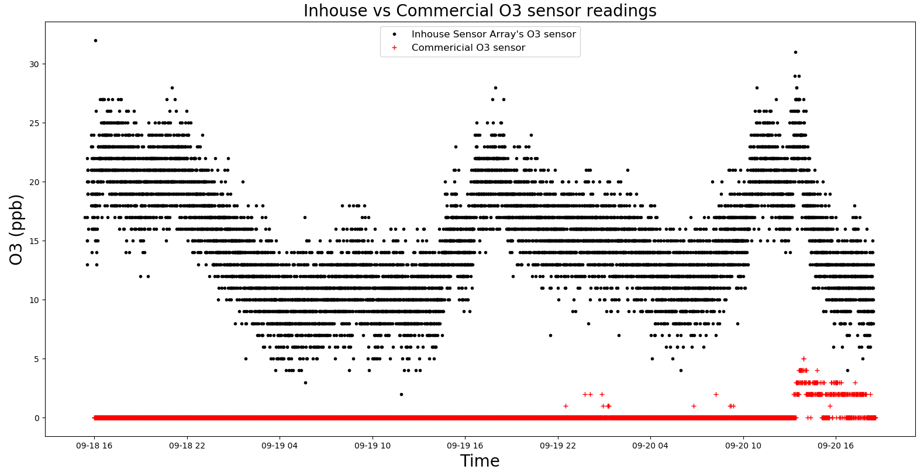
Sensor Array and Data Collection
Actual O₃ concentration – Commercial vs Inhouse sensor array
42
Notes:
The variation of O3 during the time 4pm afternoon of 18th September to 4pm of 20th September for inhouse sensor array and a commercial sensor.

Slide 43
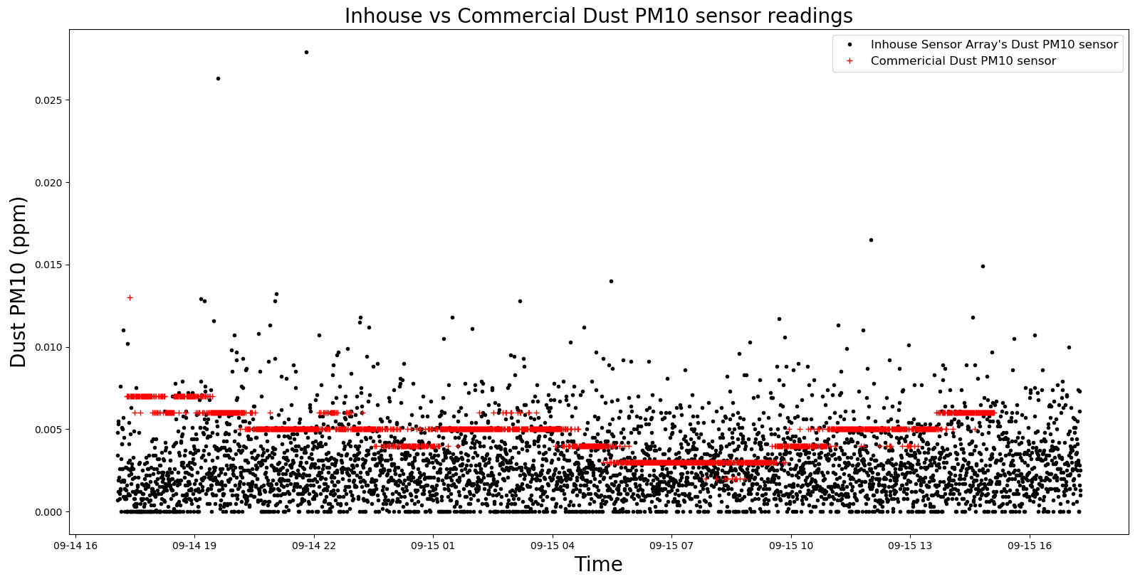
Sensor Array and Data Collection
Actual PM10 concentration – Commercial vs Inhouse sensor array
43

Slide 44
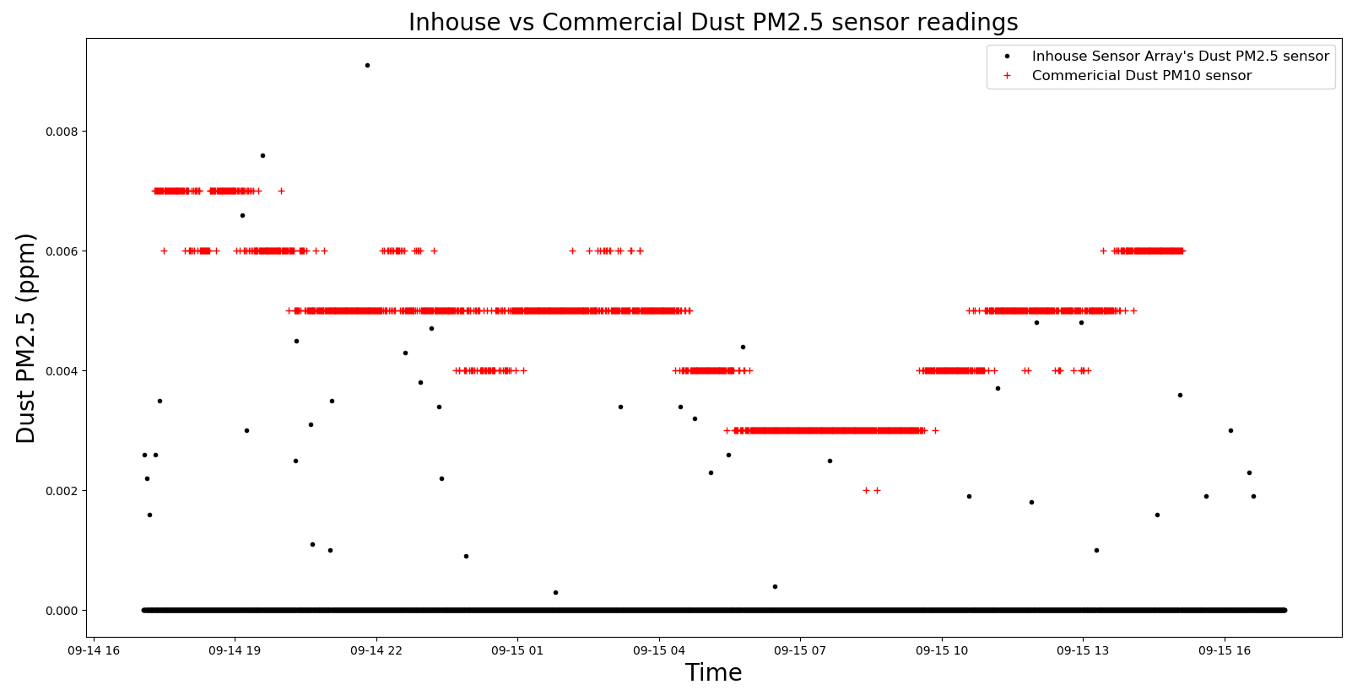
Sensor Array and Data Collection
Actual PM2.5 concentration – Commercial vs Inhouse sensor array
44

Slide 45
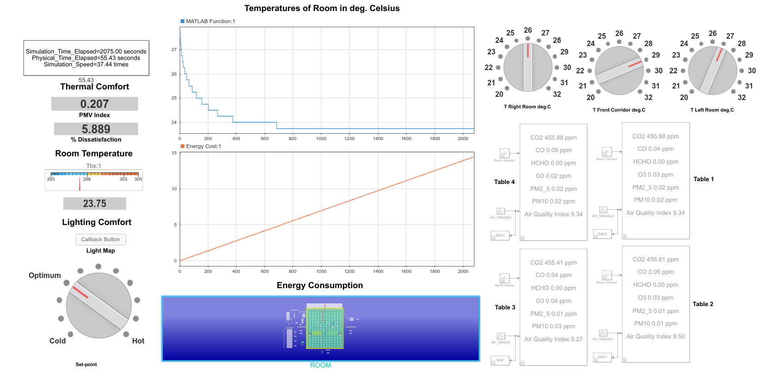
Discussion of Results
GUI in Simulink for the IEQ system
45

Slide 46
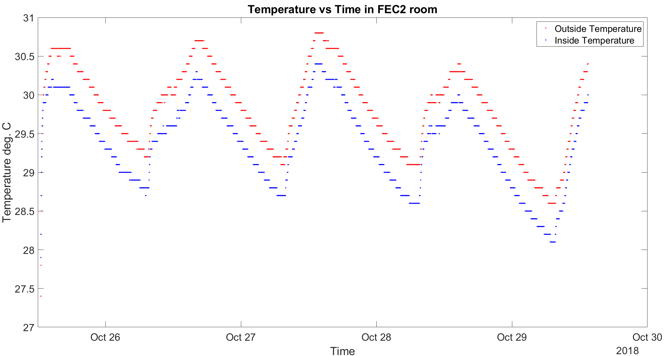
Discussion of Results
Thermal Comfort
Actual Temperature variation between Indoor and Outdoor in deg. C in FEC2 room
46

Slide 47
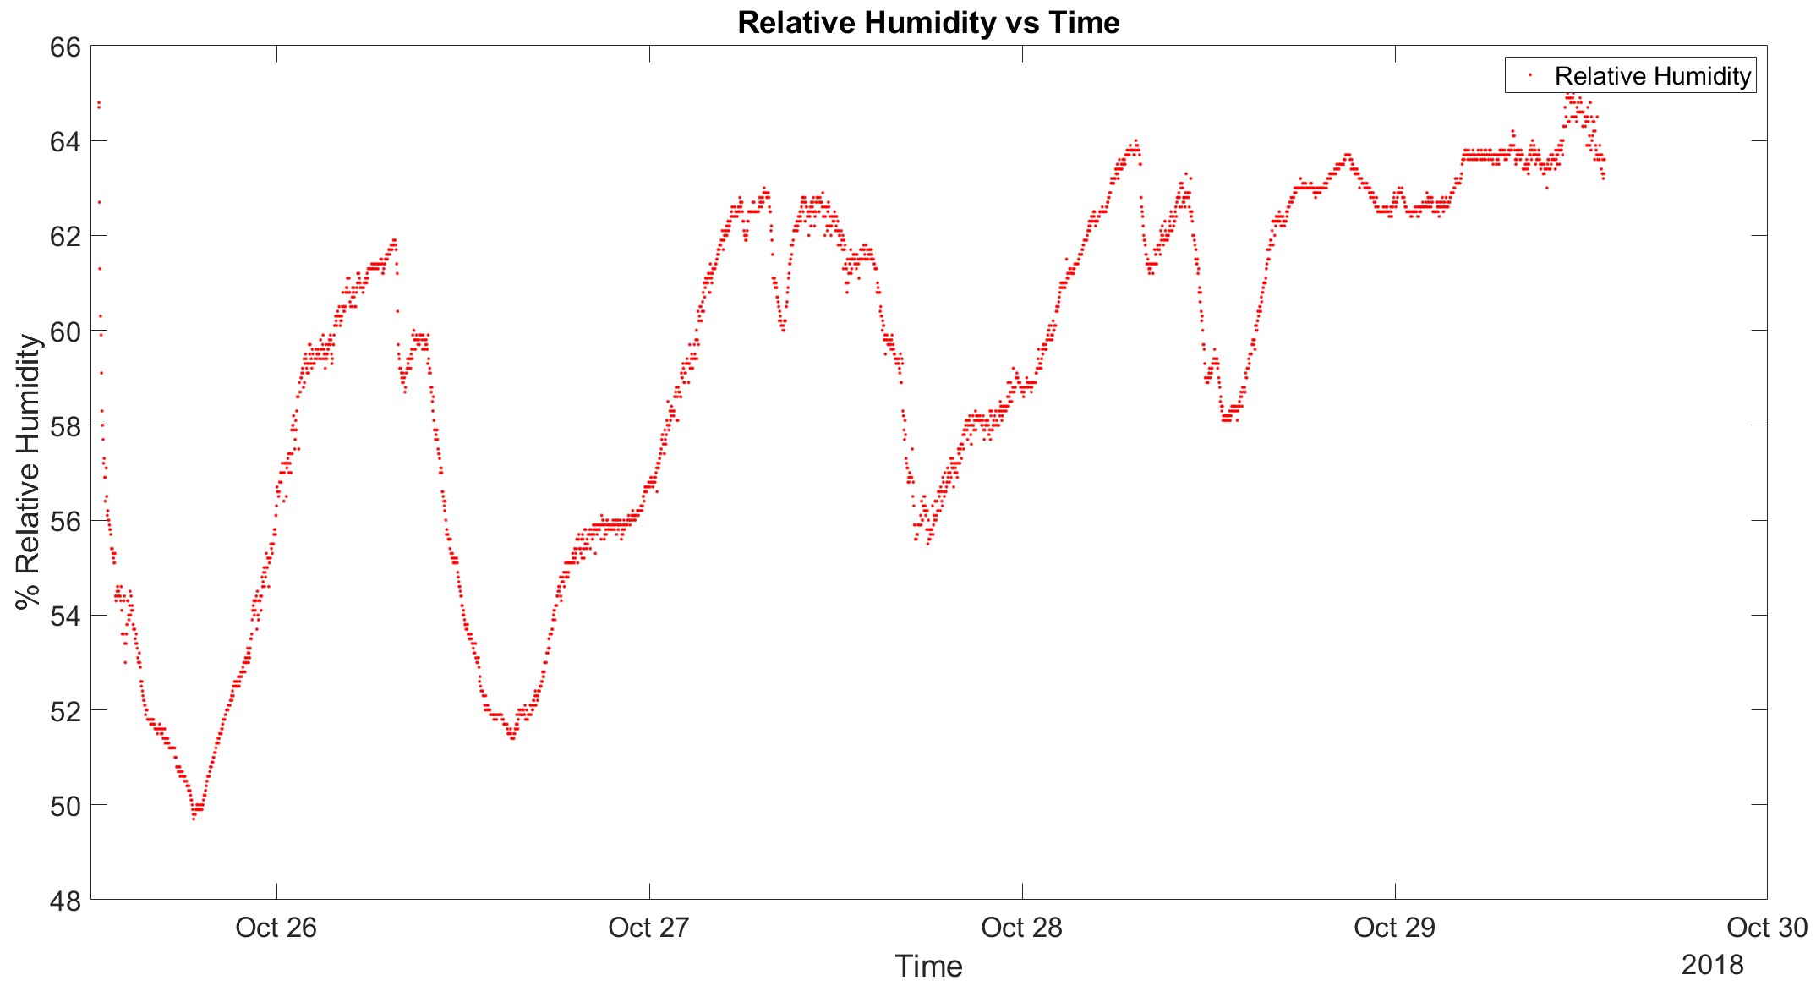
Discussion of Results
Actual Humidity variation in the FEC2 room
47

Slide 48
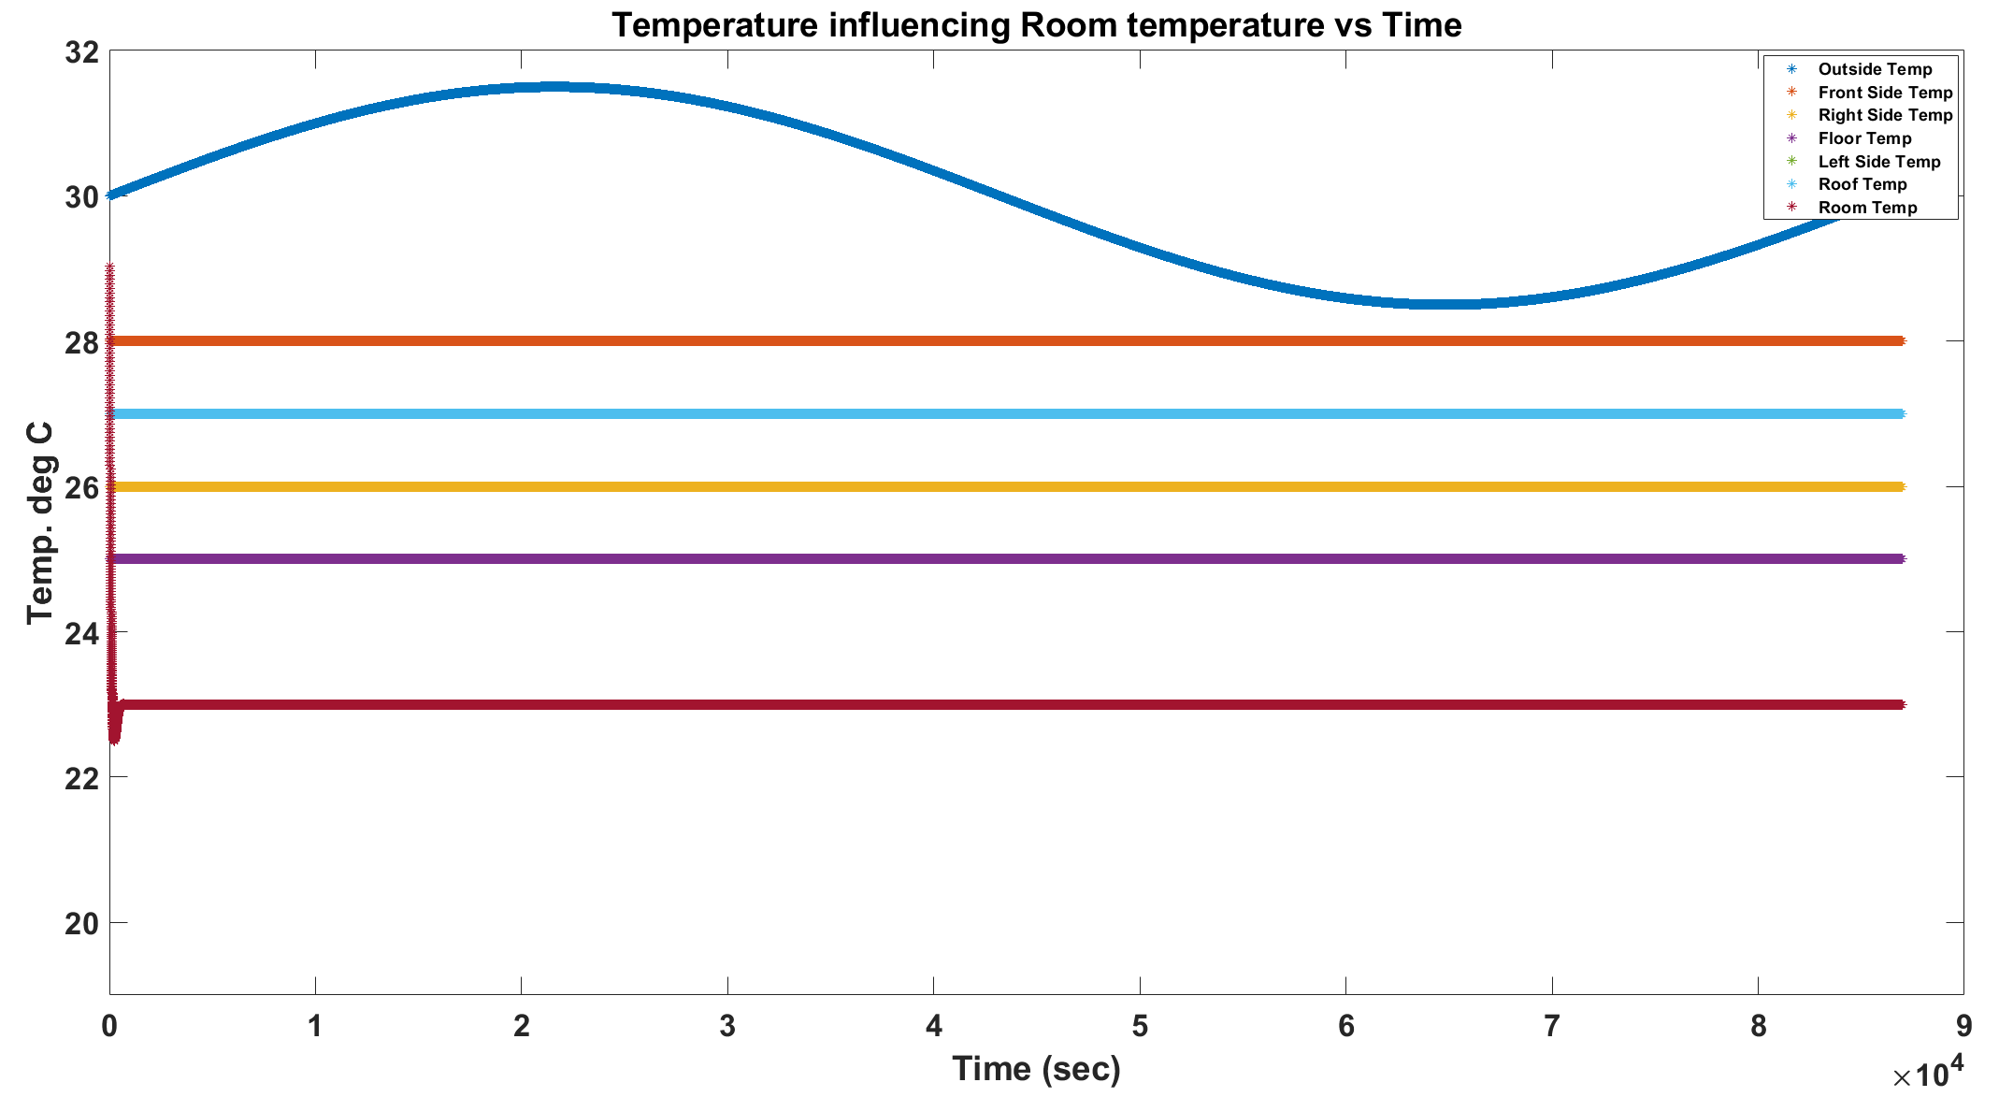
Discussion of Results
Simulated Temperature variation in the room
48

Slide 49
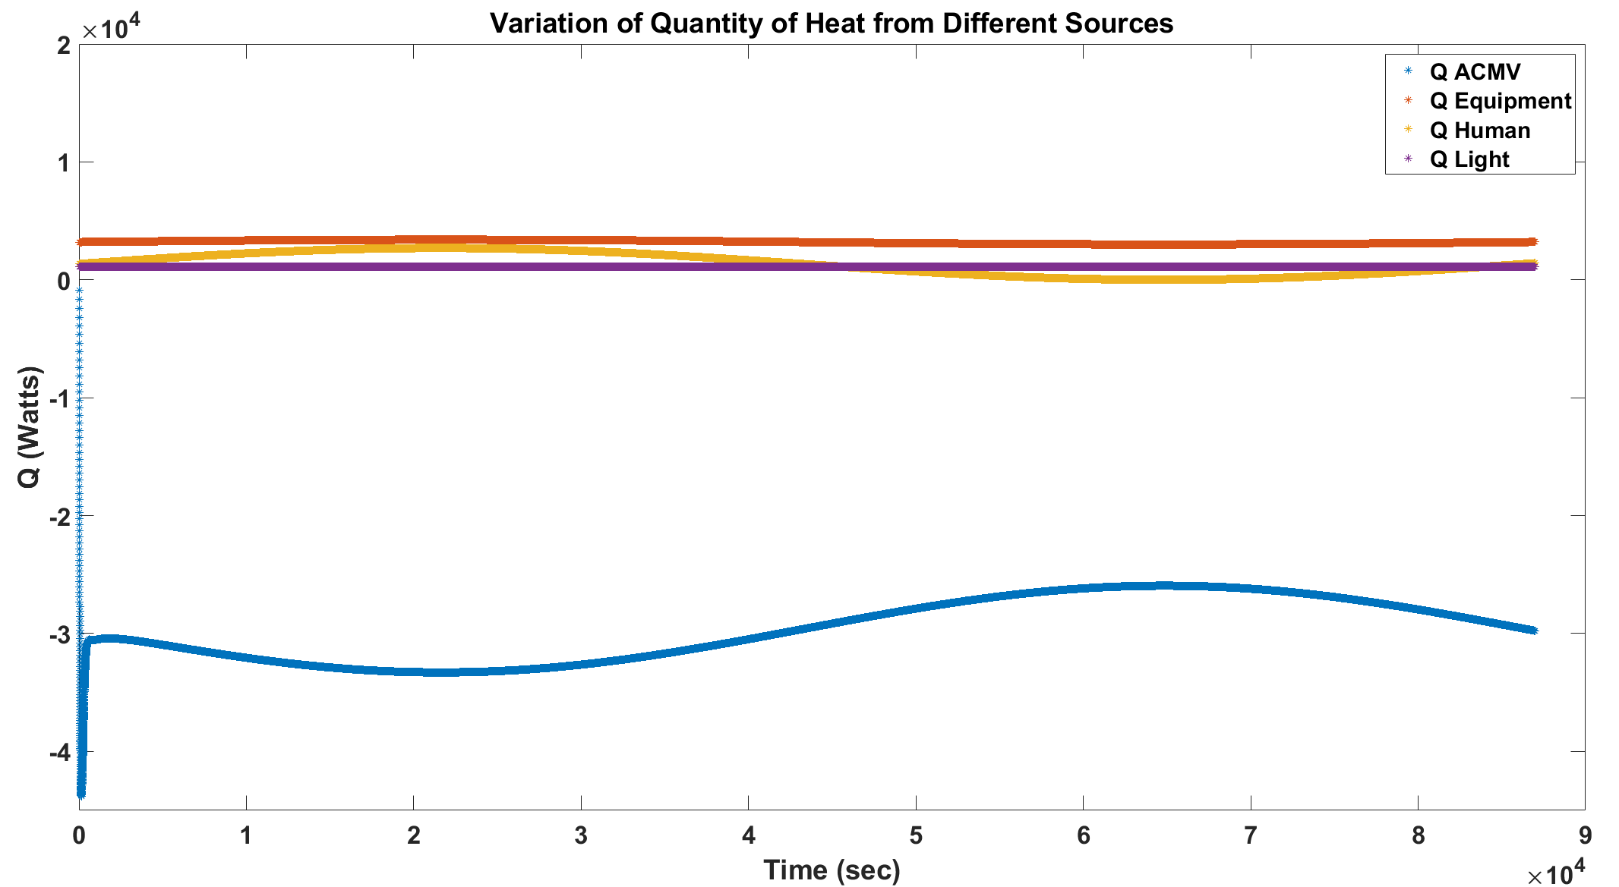
Discussion of Results
Simulated Heat Gains in the room
Qacmv is calculated based on the cooling load calculation
49

Slide 50
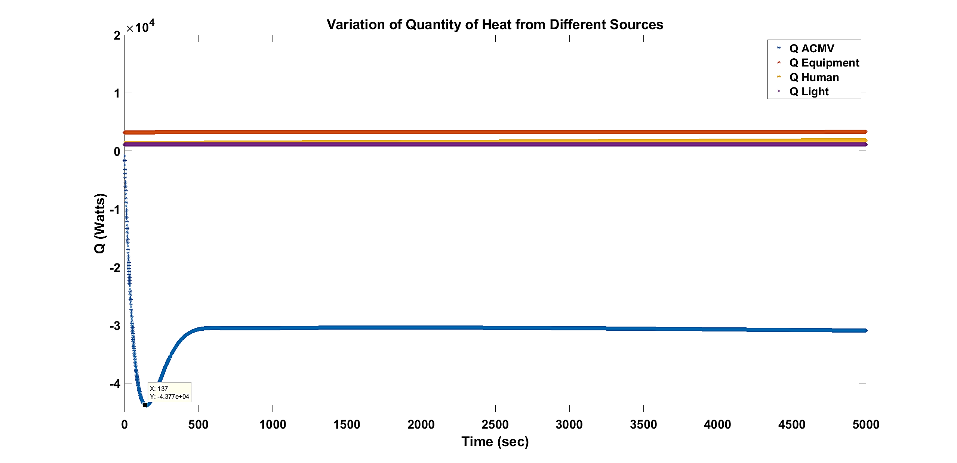
Discussion of Results
Simulated Heat Gains in the room
Qacmv with policies
50

Slide 51
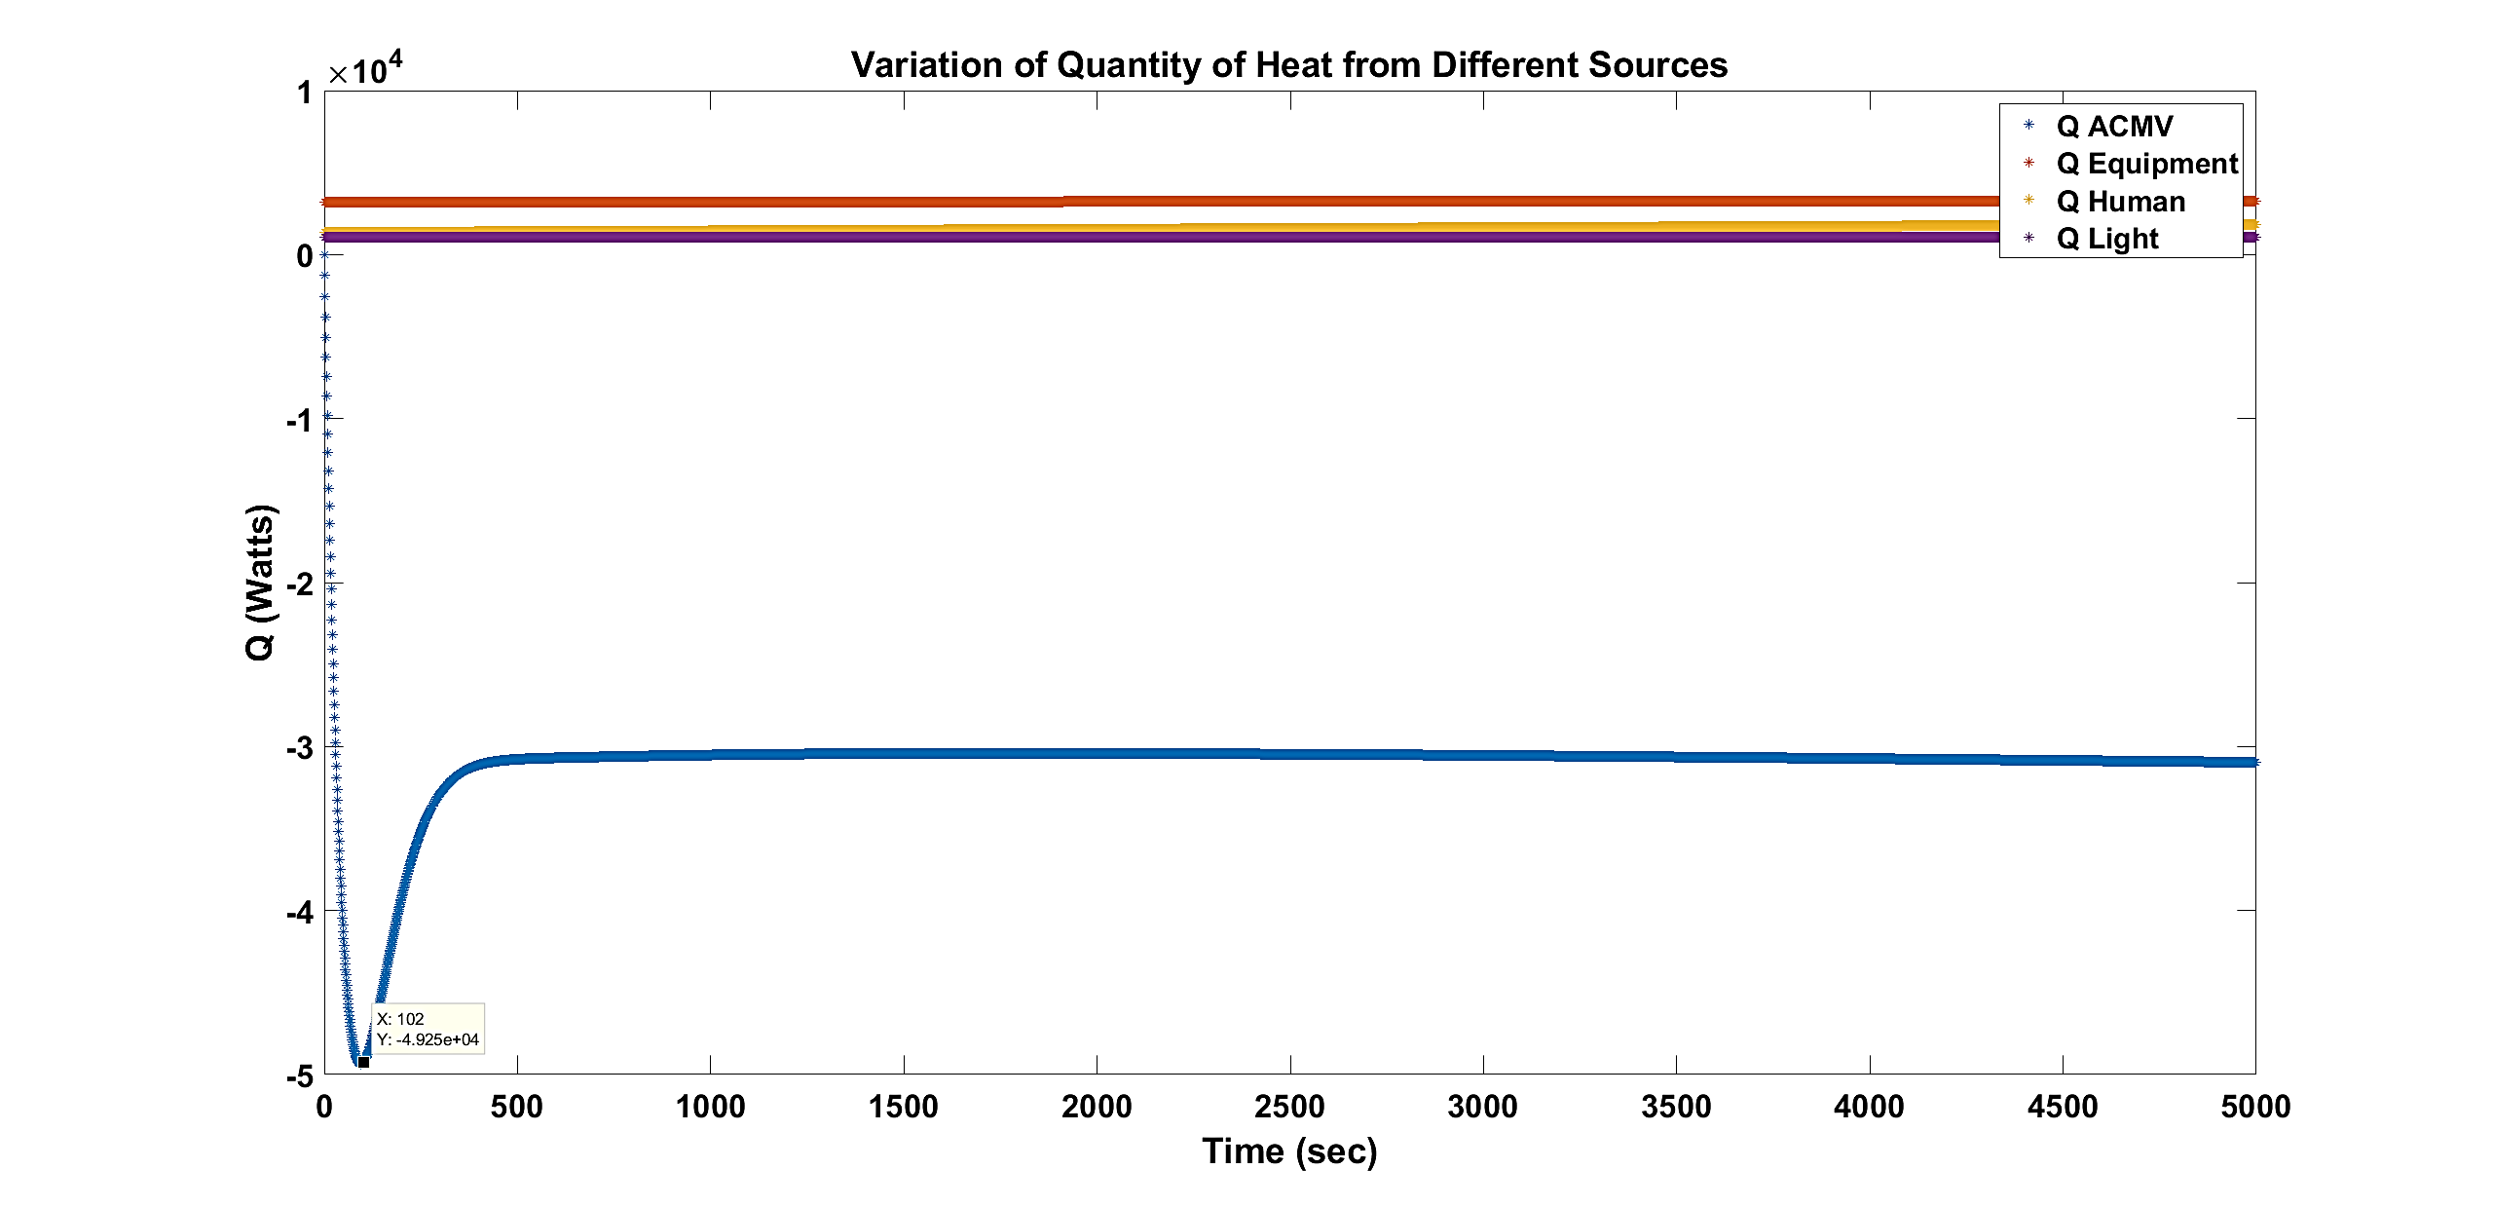
Discussion of Results
Simulated Heat Gains in the room
Qacmv without policies
51

Slide 52
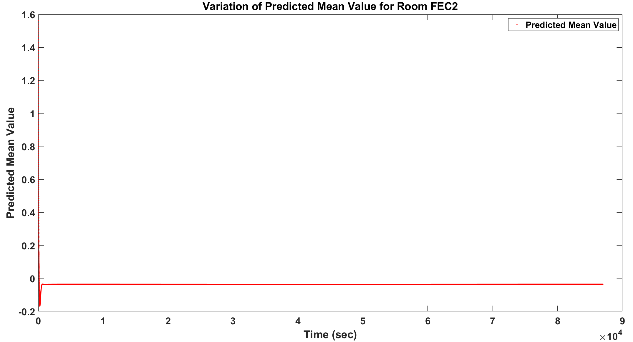
Discussion of Results
Predicted Mean Value of Thermal Comfort based on simulated temperature variations
52

Slide 53
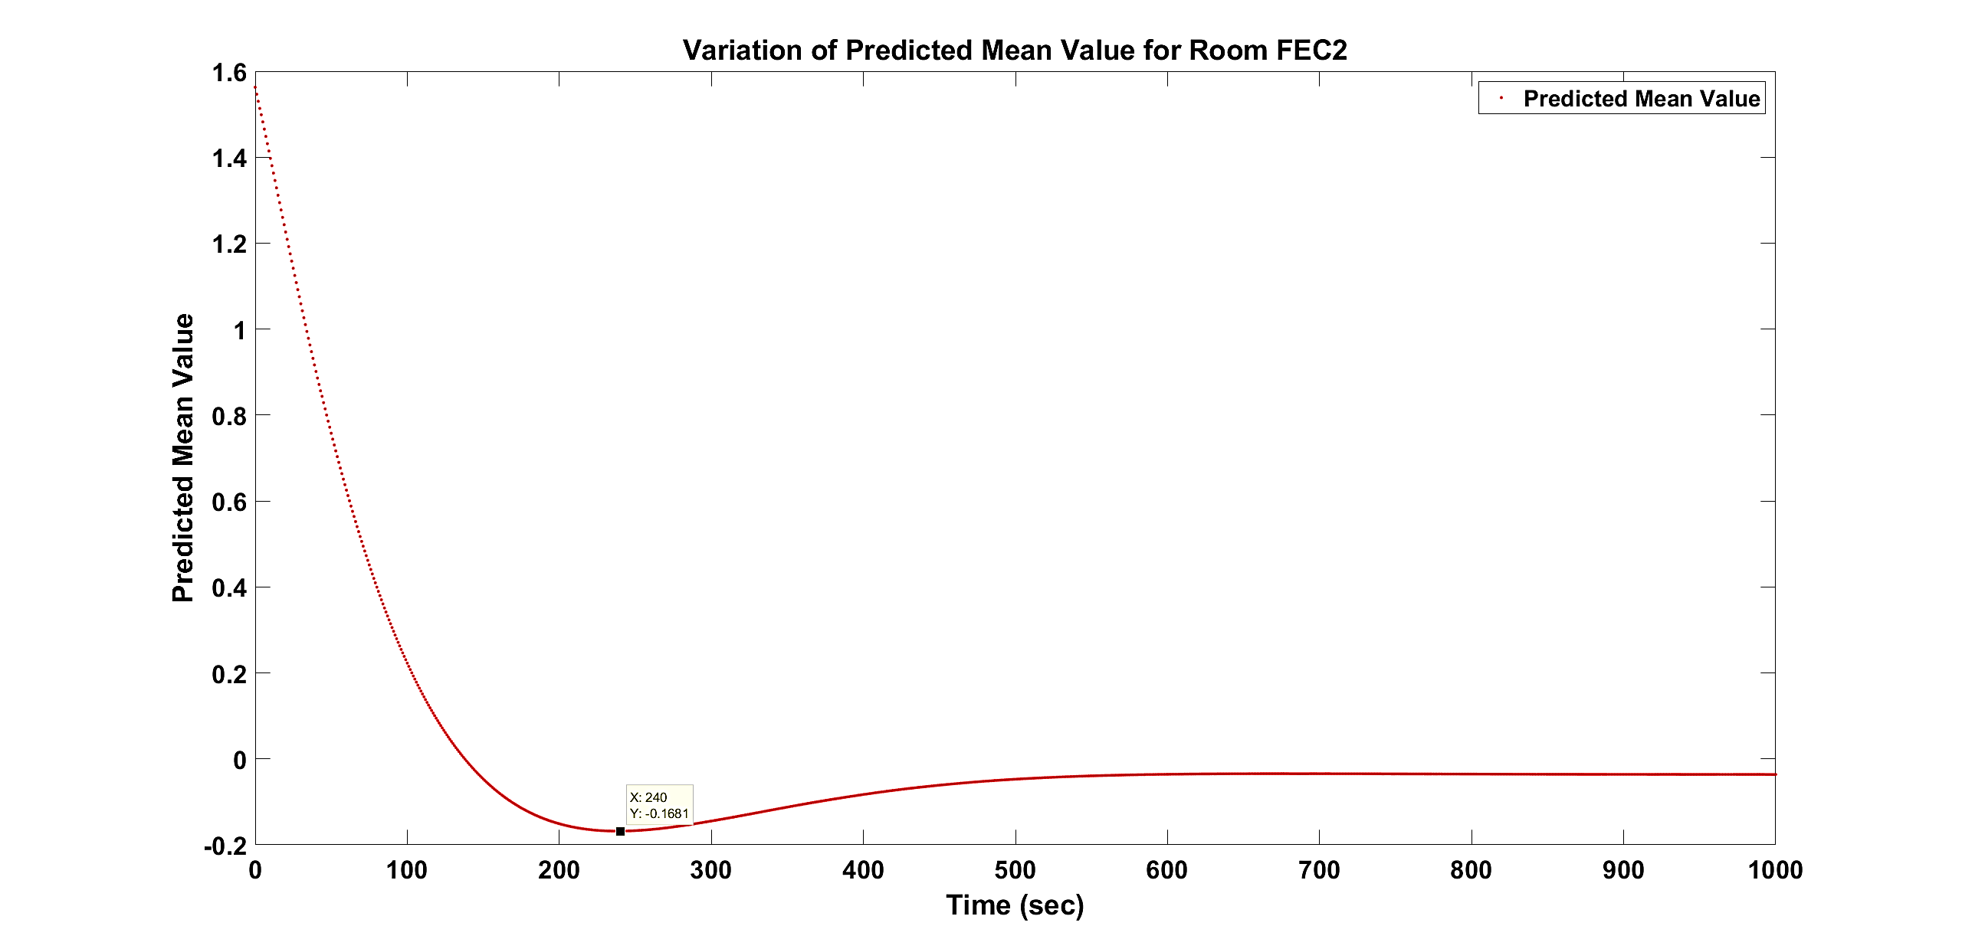
Discussion of Results
Predicted Mean Value of Thermal Comfort with policies
53

Slide 54
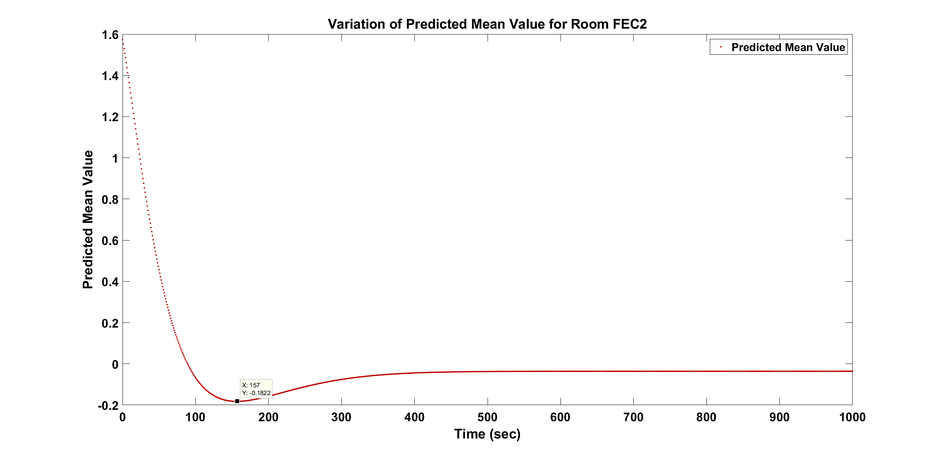
Discussion of Results
Predicted Mean Value of Thermal Comfort without policies
54

Slide 55
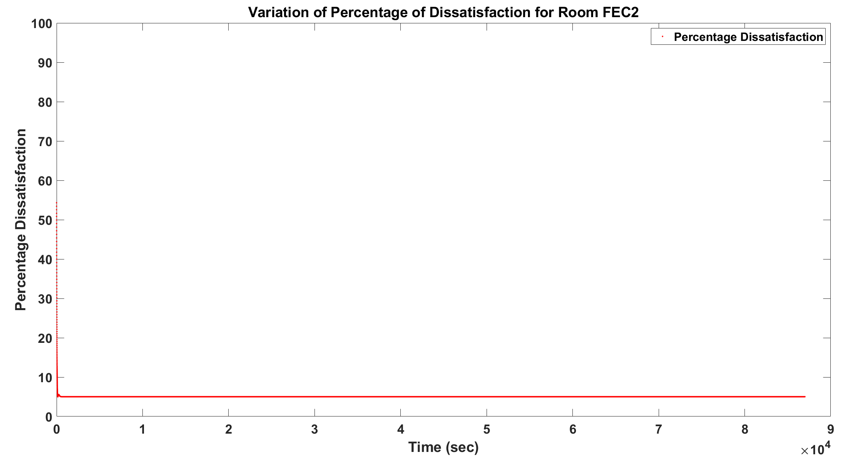
Discussion of Results
Predicted percentage of Dissatisfaction of Thermal Comfort based on simulated temperature variations
55
Notes:
Initially the percentage is around 55% of dissatisfaction for temperature of 28 deg C initial temperature. Later it decreases to about 5%.

Slide 56
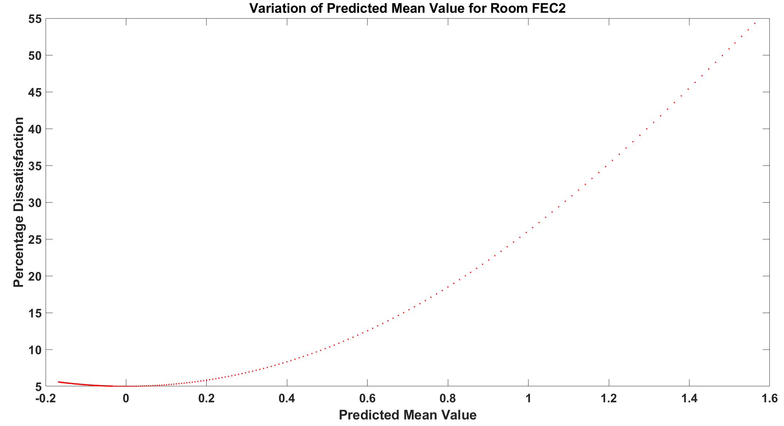
Discussion of Results
Predicted Mean Value vs PPD of Thermal Comfort based on simulated temperature variations
56
Notes:
Simulated temperatures, relative humidty and air velocity has resulted in relationship between PMV and PPD in the warmer side of the curve

Slide 57
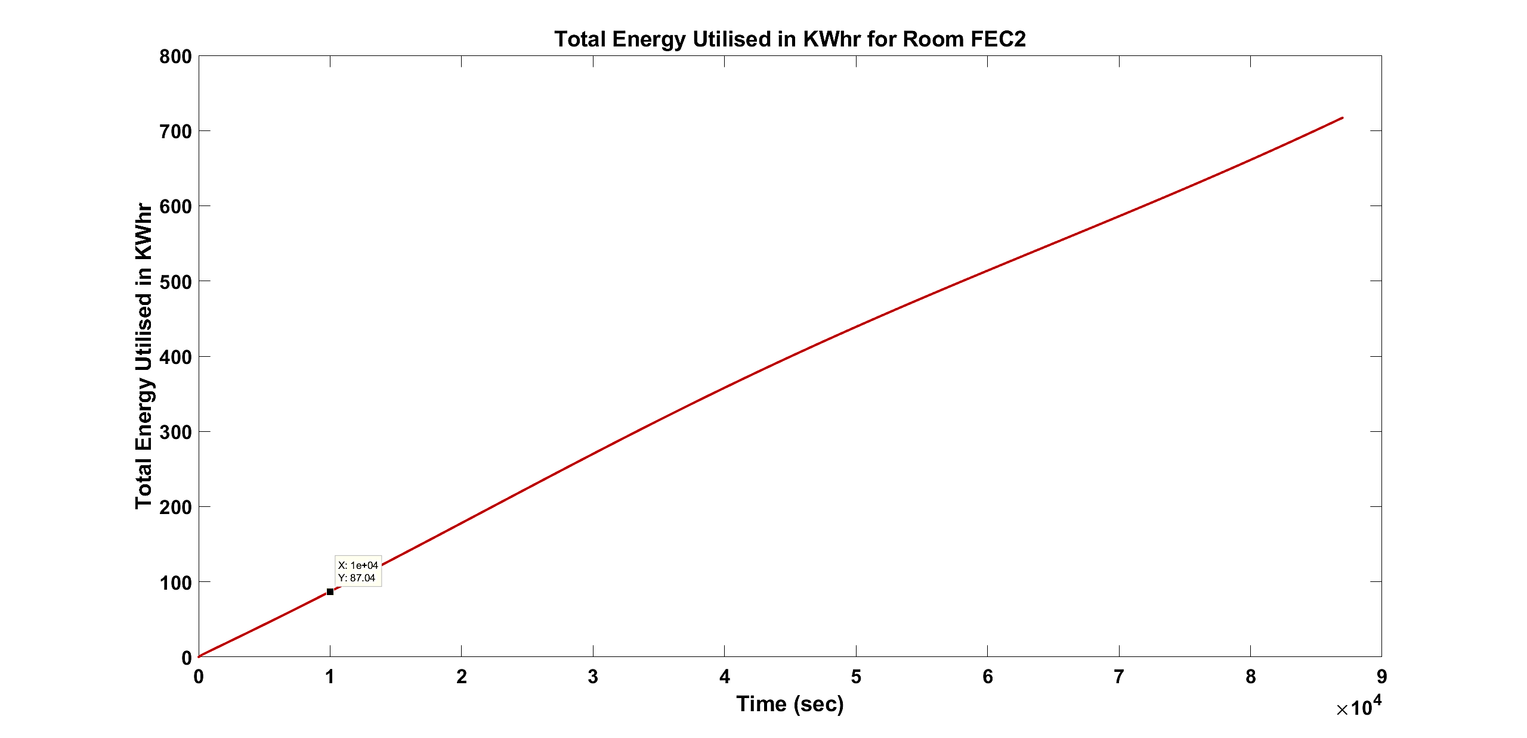
Discussion of Results
Energy cost without policies being implemented
57

Slide 58

Discussion of Results
Energy cost with policies being implemented
58

Slide 59

Discussion of Results
Air Quality
Simulated CO2 variation in the room at 4 Tables
59

Slide 60

Discussion of Results
Simulated Gas Concentration variation in the room at 4 Tables
Constant after some time as no external variation of data available
60
Notes:
Concentration at various tables with assumption that some tables are away from the inlet duct and hence the concentration of the gases are negligible to be accounted for.

Slide 61

Discussion of Results
Air Quality Index variation from Simulated Concentration of gases
61
Notes:
Below 50 AQI is optimum as human beings are present in the room the concentration of CO2 increases and hence the AQI hovers around the 100 mark.

Slide 62

Discussion of Results
Lighting Quality
Lightmap of the room FEC2
62

Slide 63

Discussion of Results
Lighting Index at each point of measurement taken in room FEC2
63

Slide 64

Discussion of Results
Lighting Comfort Level at each point of measurement taken in room FEC2 ranging from -2 to 2
64

Slide 65
Conclusion
IEQ monitoring was done by GUI in MATLAB Simulink based on simulated environment. Agent system was implemented based on policies but control of environment not taken rather indices were given for user information and thereby variation of set-point from user.
Future work may include: Development of phone application for user input and feedback.
65

Slide 66

Related Work
Android App for User Preference
66

Slide 67
THANK-YOU
67

Slide 68
APPENDIX
Indoor Air Quality:
Parameter | Averaging time | Limit of Acceptability | Unit
Carbon dioxide | 8 hours | 1000 | ppm
Carbon monoxide | 8 hours | 9 | ppm
Formaldehyde | 8 hours | 0.1 | ppm
Ozone | 8 hours | 0.05 | ppm
Suspended Particles | - | 150 | µg/m3
Volatile Organic Compounds | - | 3 | ppm
Regulatory level of indoor air constituents by Institute of Environmental Epidemiology,
Ministry of the Environment, Singapore
68

Slide 69
APPENDIX
Thermal Capacitance and Resistance in Electrical Analogy:
Thermal Capacitance – Capacity to store heat – analogous to Capacitance in electrical circuit.
Thermal Resistance – Resists the flow of heat - analogous to Resistance in electrical circuit.
Flow of heat Q – Analogous to current in the circuit.
Temperature Difference between two surfaces – Analogous to Potential difference in electrical circuit.
69

Slide 70
APPENDIX
70

